Slide 1
Arrays
Arrays in Visual Basic and JavaScript

Slide 2
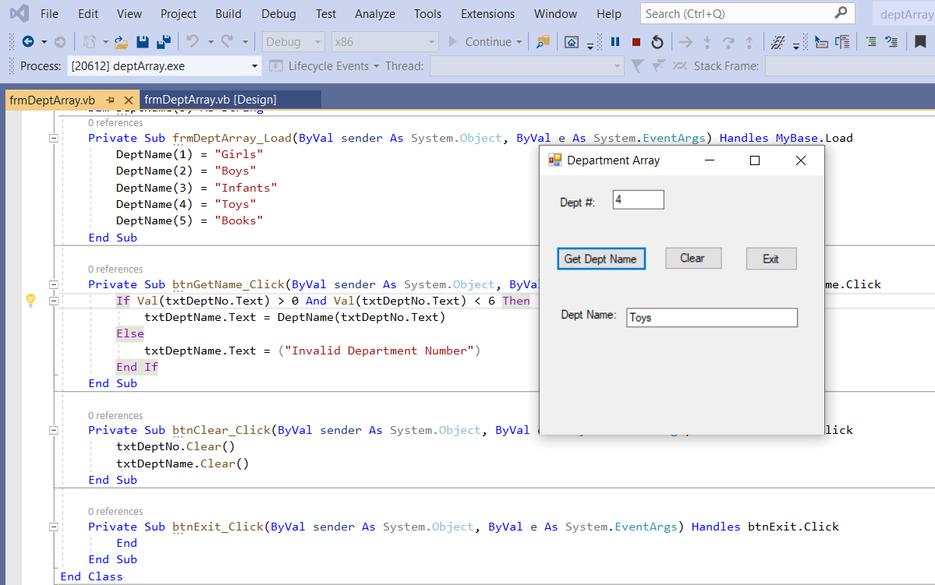

Slide 3
An array is a collection of data each with the same name. The fact that the name is the same means there needs to be a way to tell one name from the similar name. This is done through indexes (also called subscripts and pointers).
So… I have set up a variable array called DeptName(5) and I have put a 5 in the parenthesis to indicate that I am going to be able to use indexes up through 5. I defined the array in the global area as a string. To do this I wrote Dim DeptName(5) as String.
Now I double-click on a blank area on my form and the Load event is created. The Load event happens when the form is loaded. In the Load event I am going to put data in the array. So I put in DeptName(1) and gave it a value of “Girls”. Then I put in DeptName(2) and gave it a value of “Boys”. The last one is DeptName(5) which has a value of “Books”.
Note that I could have made a DeptName(0) but since there was no dept 0, I did not do that.

Slide 4
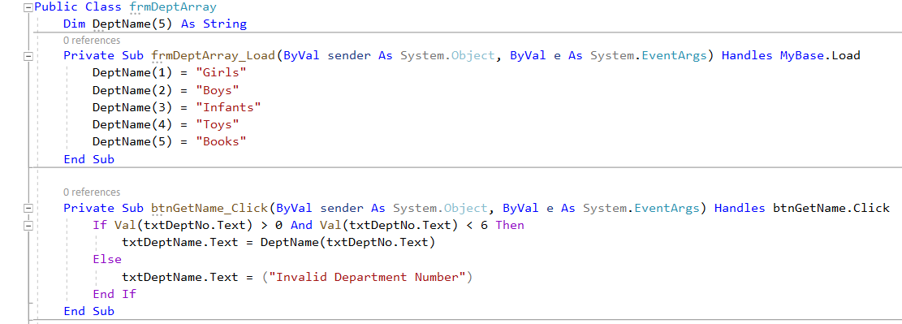
Now I want to retrieve a name from the array. I ask the user to enter a dept number and I want to go and get the name that matches that dept number. So I enter the number and click the button. The btnGetName_Click event will be executed. First I want to check and make sure they enter a valid number, so I ask if the txtDeptNo.Text is greater than 0 and less than 6. That means it is valid so I can code take the txtDeptNo.Text and use it as the index to get the right DeptName. This means I write DeptName(txtDeptNo.Text). It goes to the array and uses the txtDeptNo.Text to extract the DeptName it points to and put in on the form in the txtDeptName.Text box.
Note that if the txtDeptNo.Text is not in the right range, an error message is move to txtDeptName.text.

Slide 5
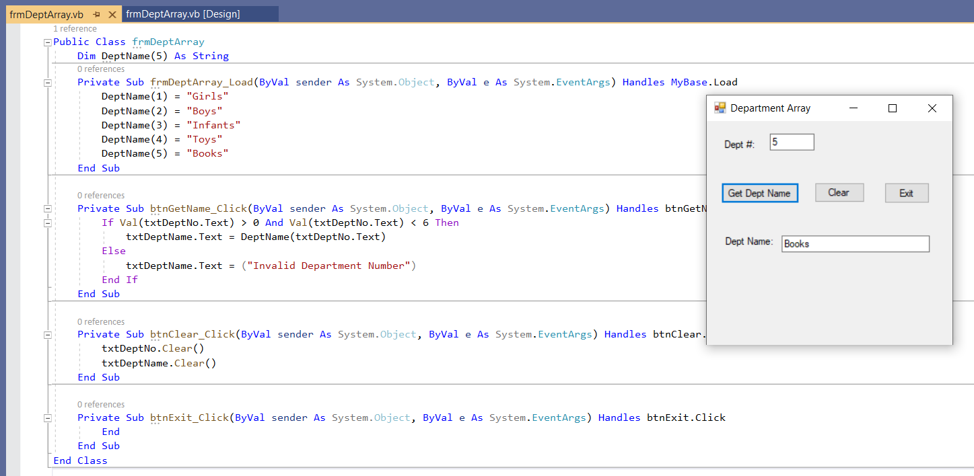

Slide 6
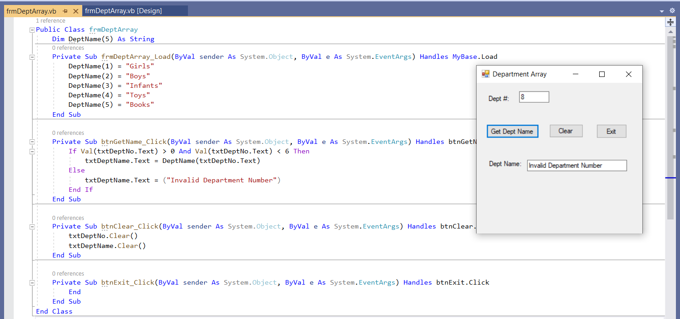

Slide 7
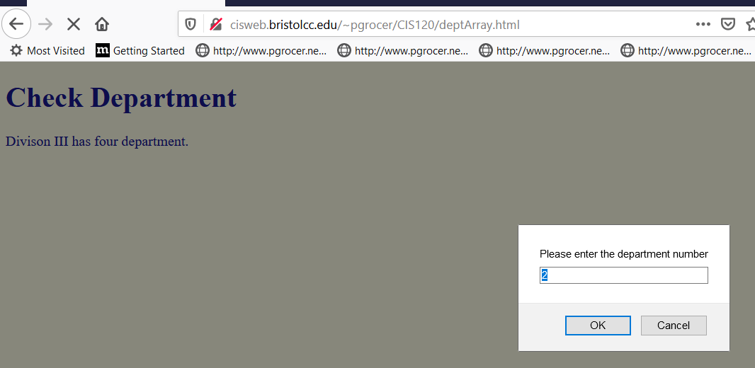
Now let’s look at an array in JavaScript.

Slide 8
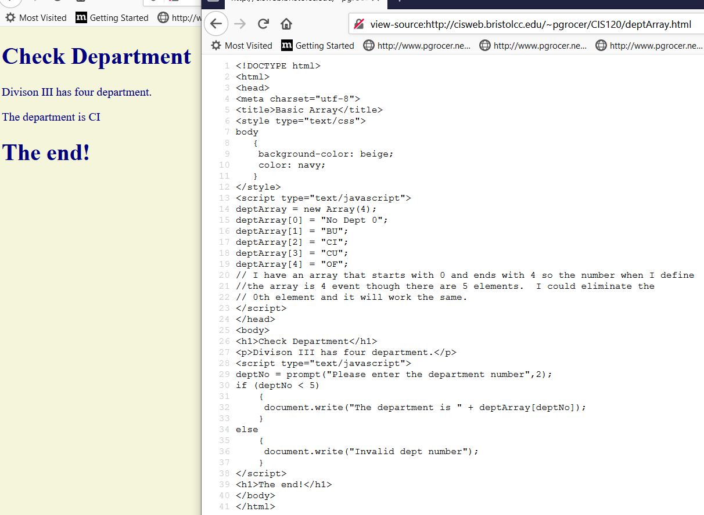
I set up deptArray as a new Array that can have an index up to 4. Notice that on this one I decided to use index 0.
When you compare the two languages notice the difference in the [ ] vs the ( ).
I entered a 2 and it returned CI.
I prompt the user to take in a department number, if they do not enter one the default of 2 is used.
Here I check for deptNo < 5 (if I was concerned about negative numbers, I would need to change that).
If deptNo is in the valid range, I use it as an index to move the correct name from the deptArray. Otherwise I move an error message.

