Slide 1
Visual Basic
Working with an existing program

Slide 2
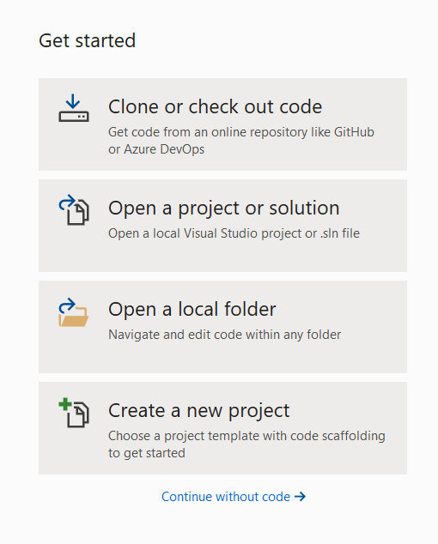
Open Visual Studio 2019 and select
Open a project or solution to work on an existing program.
This will allow you to browse and find your program.

Slide 3
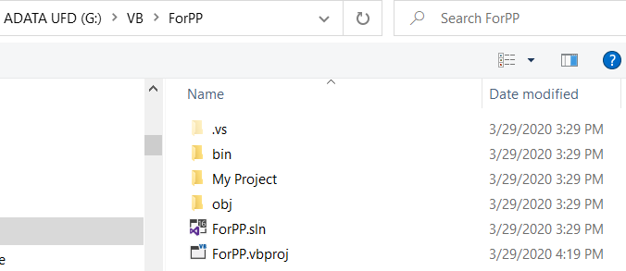
Click on the .sln to bring it up in VB.

Slide 4
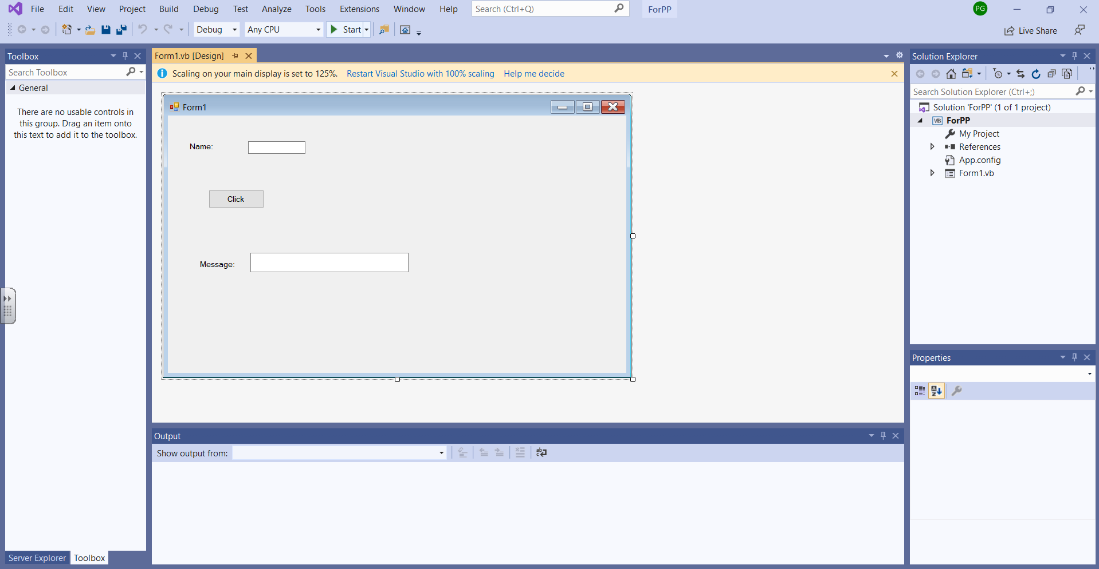

Slide 5
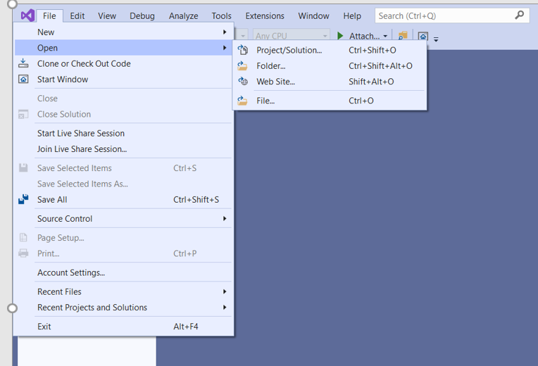
If you are in VB and want to load another program you can click on Open and then click on Project/Solution

Slide 6
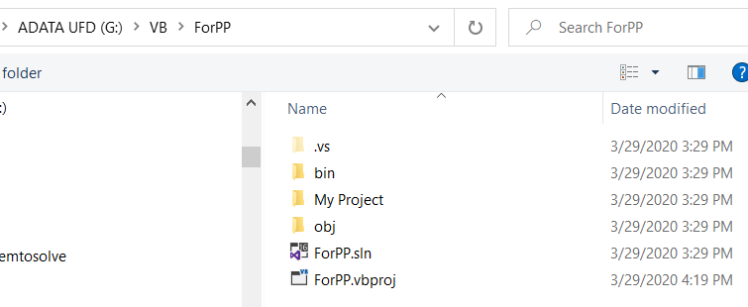
Then you can search and find your project. My project is ForPP and I am clicking on the ForPP.sln to open it.

