Slide 1
Starting Visual Basic
Starting a project and working on the project

Slide 2
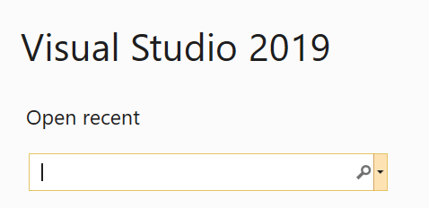
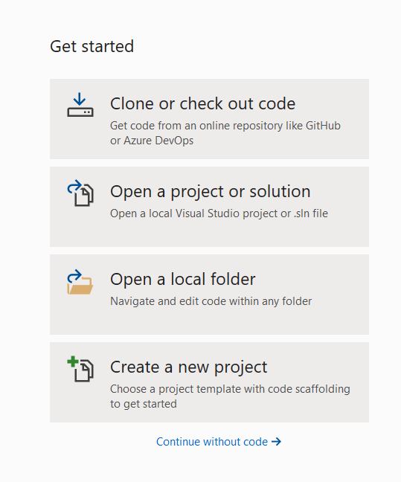
Open Visual Studio and under Get Started choose Create a new project.

Slide 3
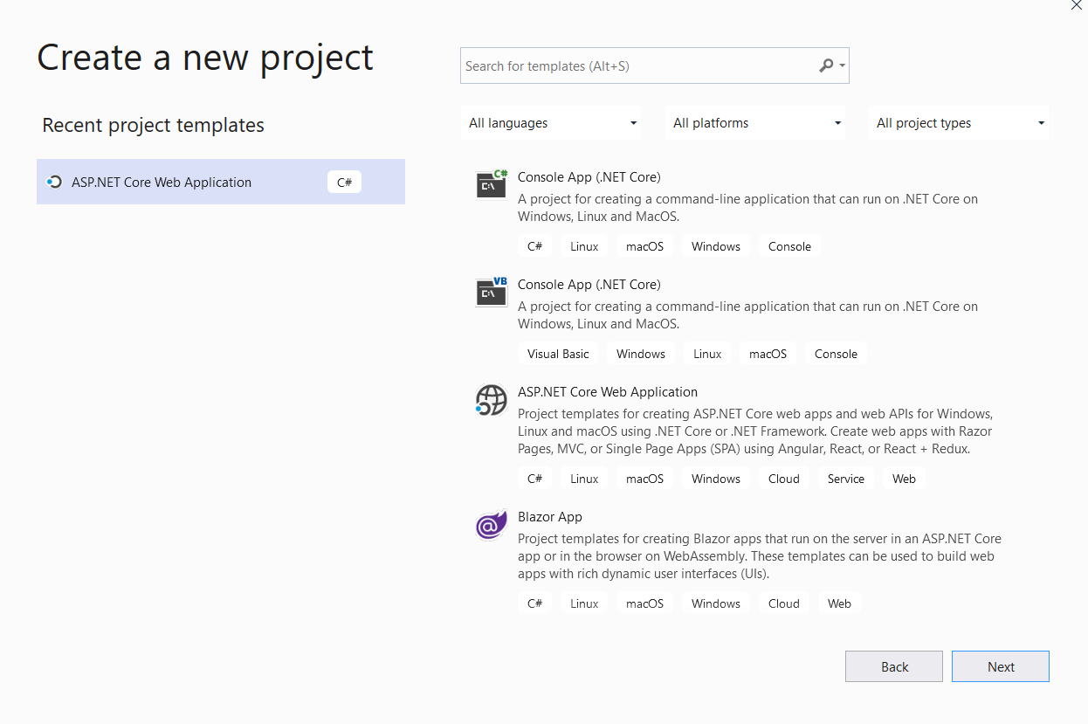

Slide 4
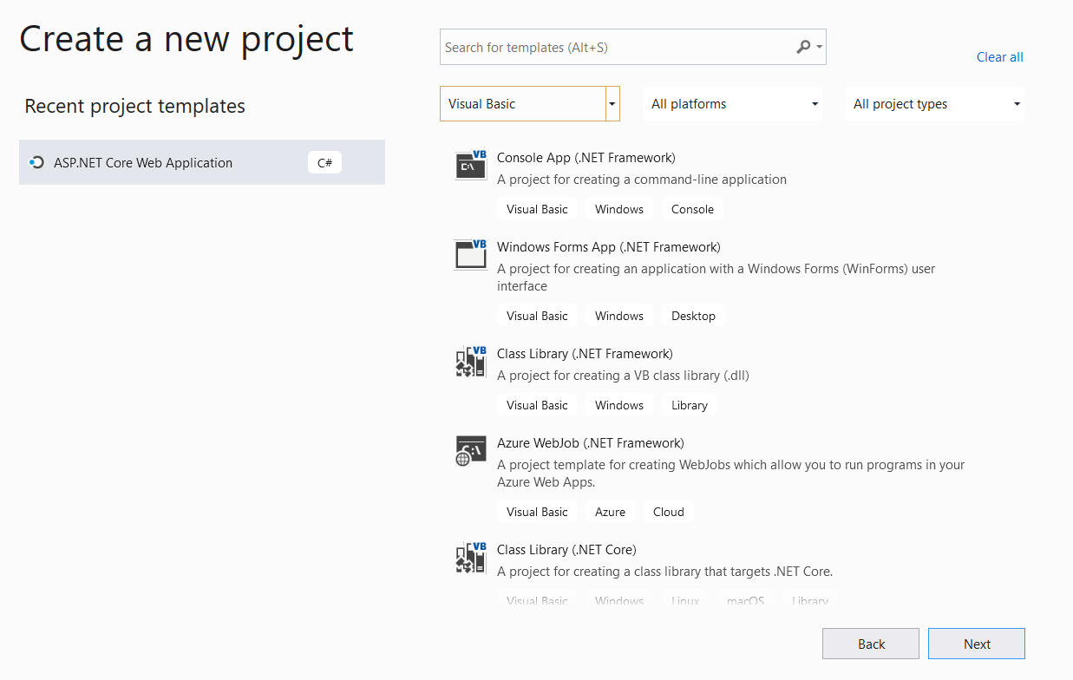
Be sure to select Visual Basic
Select Windows Forms App
(.NET Framework) to create an application with a Windows Form.

Slide 5
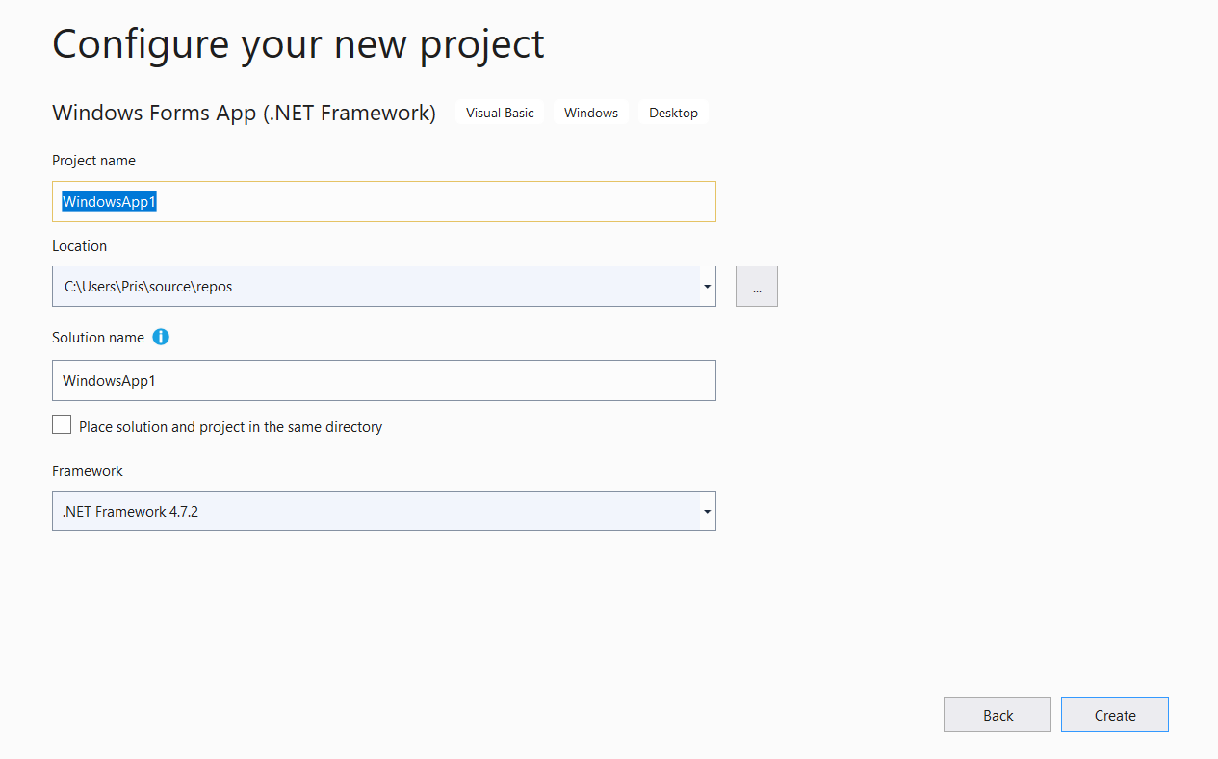
Now we need to fill in this form.

Slide 6
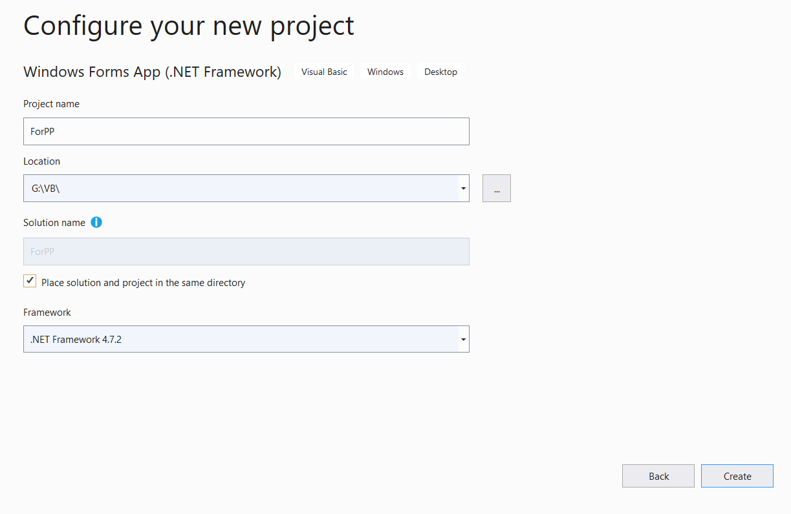
I gave the project a name.
I used … and decided on a place to put the project. I went to the G drive and create a folder/directory named VB and I am putting ForPP in that folder/directory.
I checked this box.

Slide 7
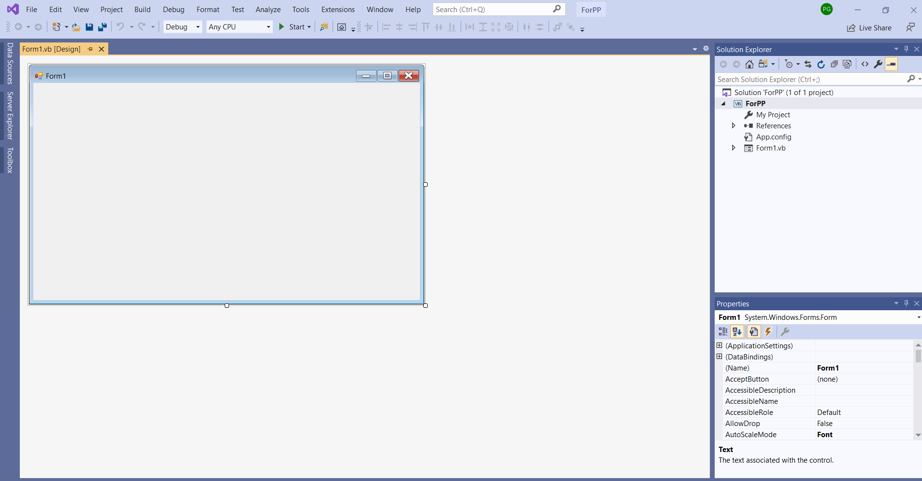
The things you need to see are:
The form
Solution explorer
Properties
Toolbox which is shown simply as a word written sideways down the left margin

Slide 8
I clicked on Toolbox to bring it up and then moved the pin at the top to point down to anchor it in place.

Slide 9
If you look under common controls you will find label. Drag it over or copy/paste so it is on the form.
It now shows up under properties and I change the default (Name) to lblName indicating that this is a label that will be for the name.

Slide 10
Now I scroll down in the Properties until I find Text. I then enter what I want to see as the label.
I put in Name:

Slide 11
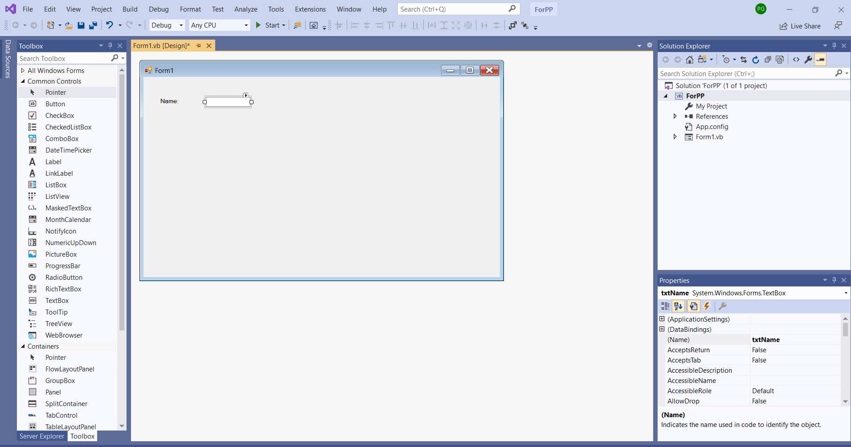
I have now dragged over a text box which I want the user to use to give a name.
I go to the properties and name it txtName.
Note that labels start with lbl and textboxes start with txt and buttons will start with btn.

Slide 12
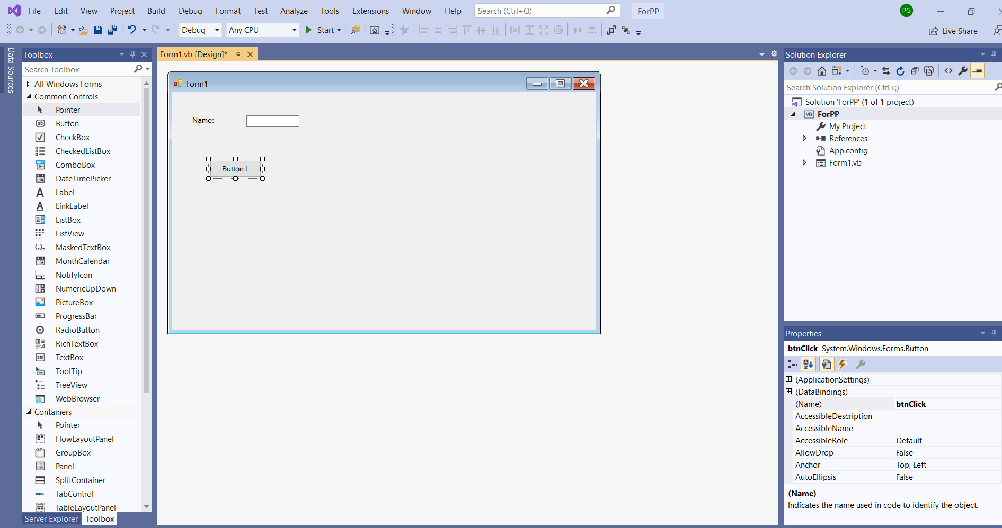
Now I have dragged over a button and have gone to properties and named it btnClick. I will now scroll down to the text property for the button and put in the name I want to appear on the button, btnClick.

Slide 13
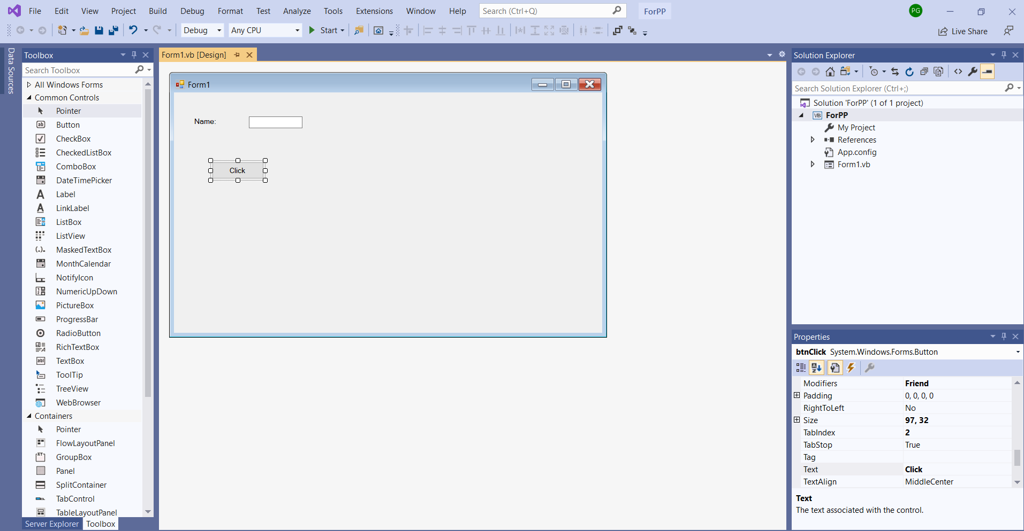
The text property of the button has been changed to Click.
Now I am going to add a label and textbox for a message I want to display.

Slide 14
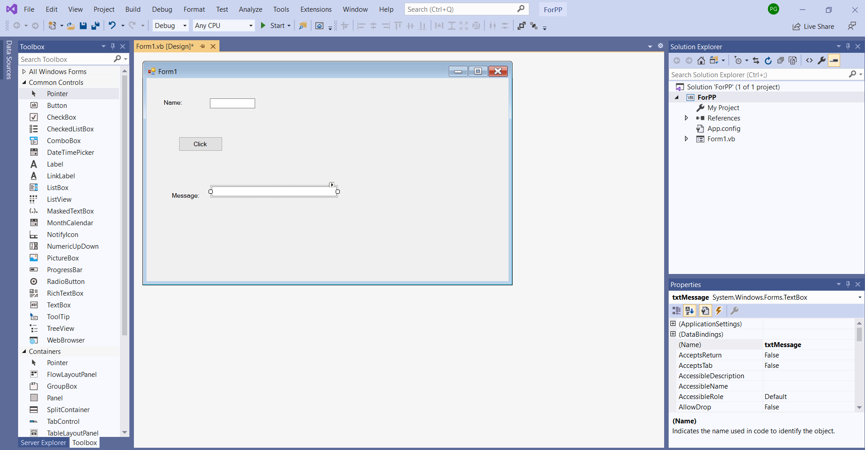
I now want to write the code that will deliver the message. I want this to happen when the button is double-clicked. So now I double click on the click button to enter the code.

Slide 15
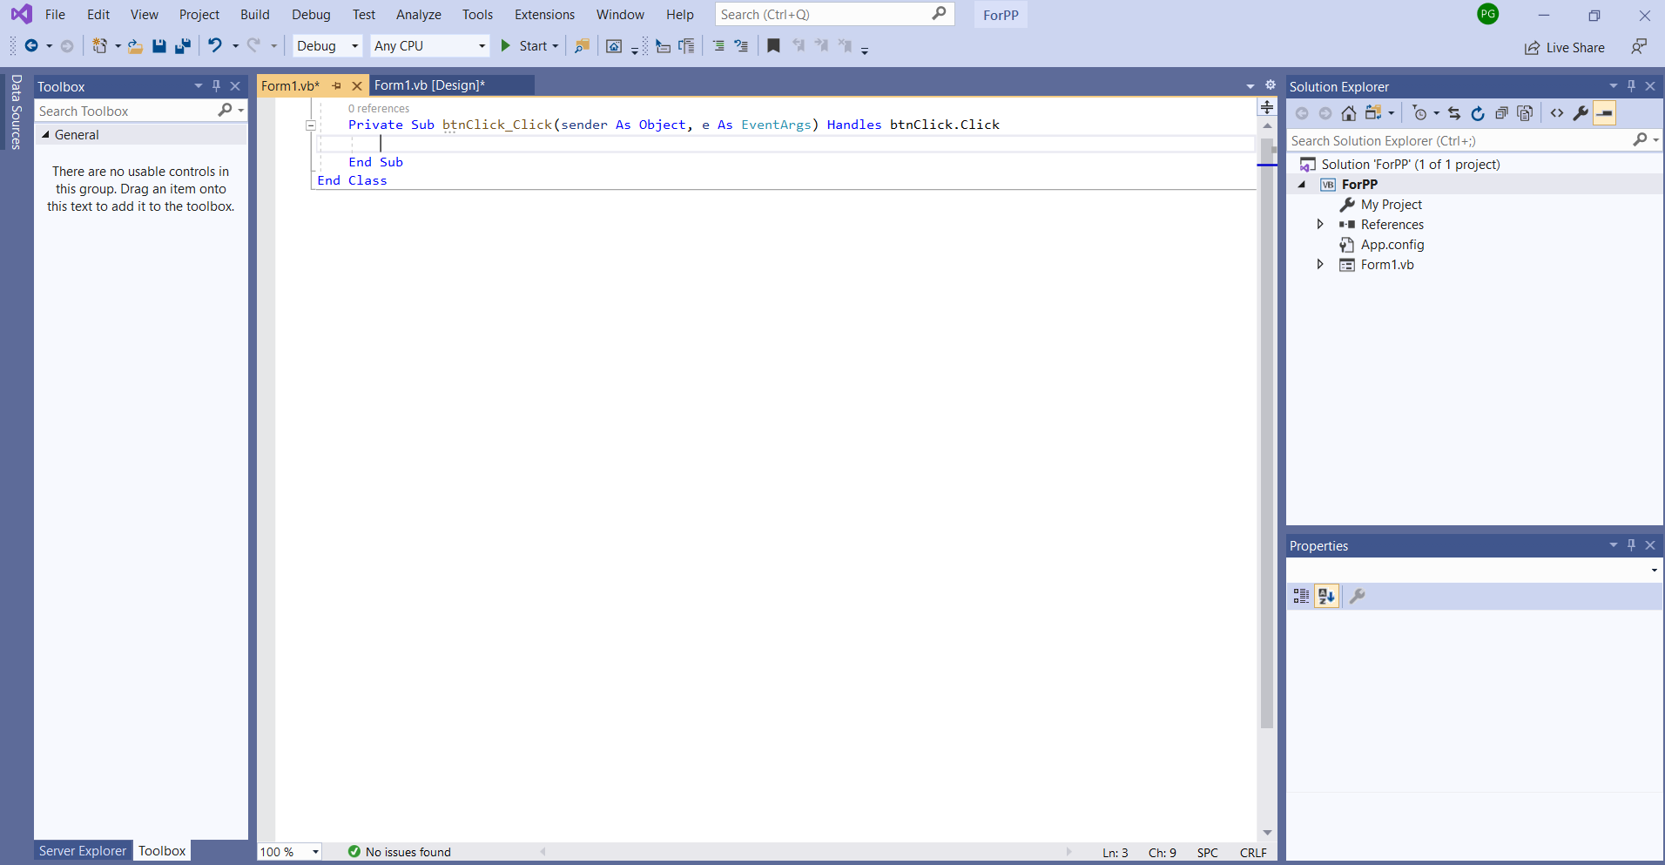
When I double-click on the button, this code is generated. It is the click event for the btnClick.
Now I need to write the code.

Slide 16
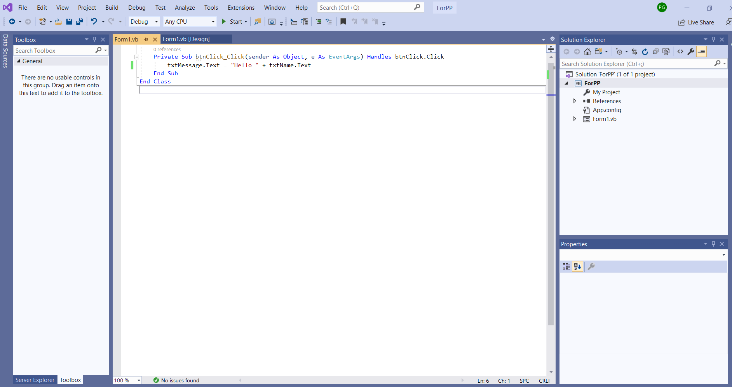
I want to change the text property of the textbox named txtMessage.text.
What I want to put in it is the concatenation of the literal Hello concatenated with the content of the textbox named txtName. I want the text property of the txtName box because that is where the user entered the name.
Note that I concatenated with the +
Note also that the literal Hello is enclosed in quotes and has a trailing space to leave a space prior to the name.
When you want to test click on the green triangle and Start to test.

Slide 17
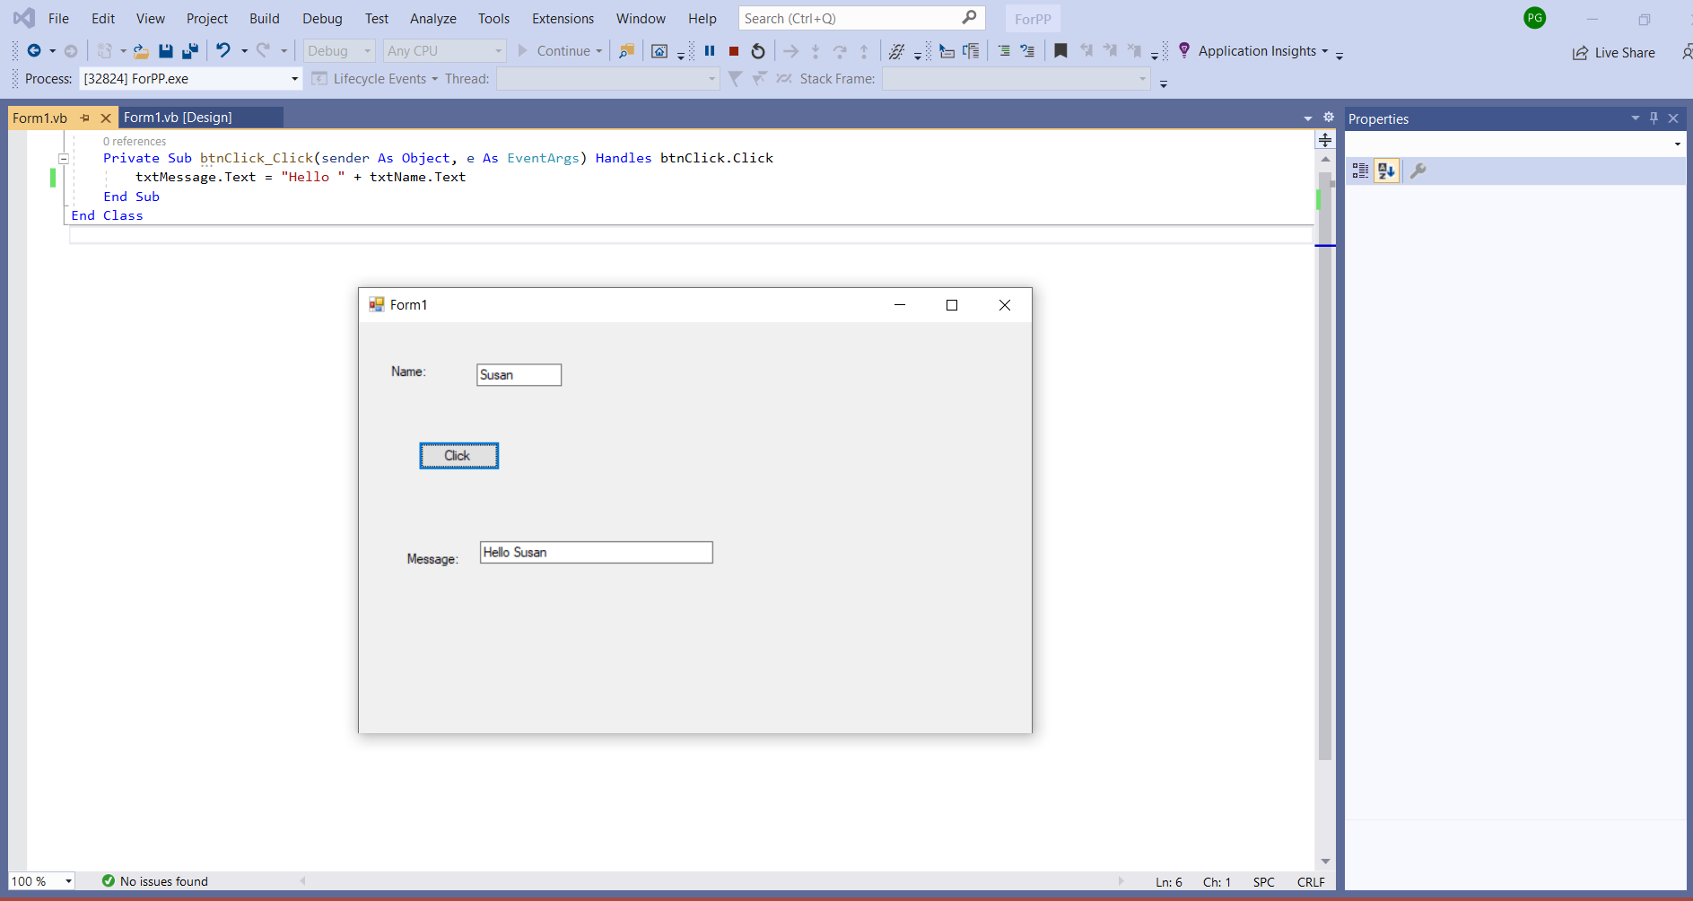
Click when you want to stop execution.

Slide 18
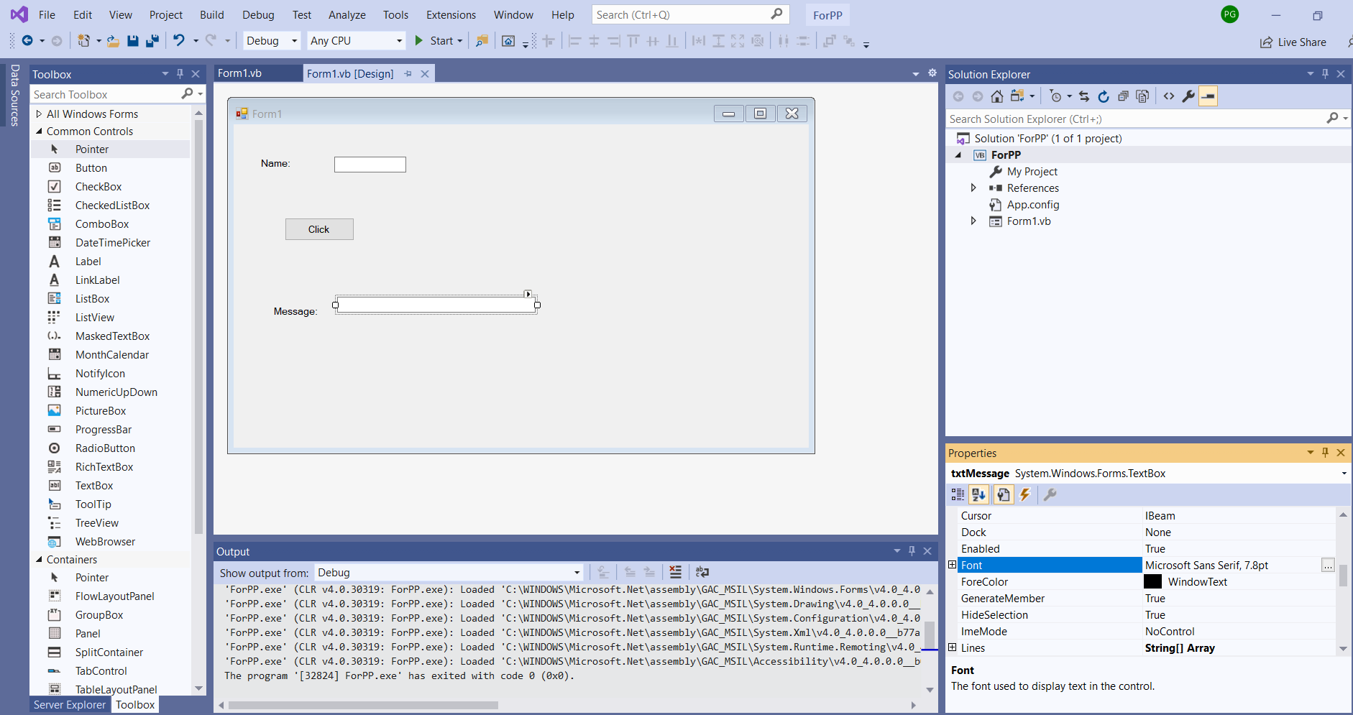
You can change other properties such as font and forecolor etc.

Slide 19
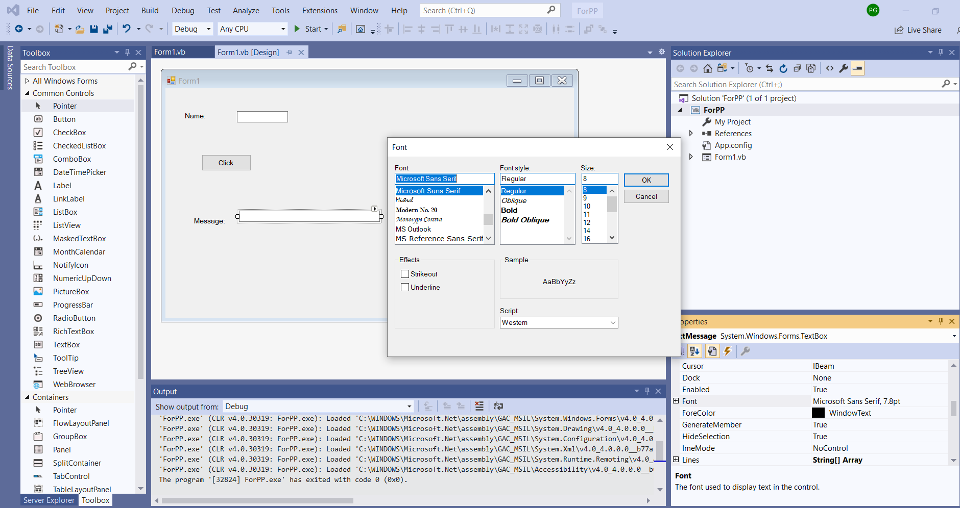

Slide 20
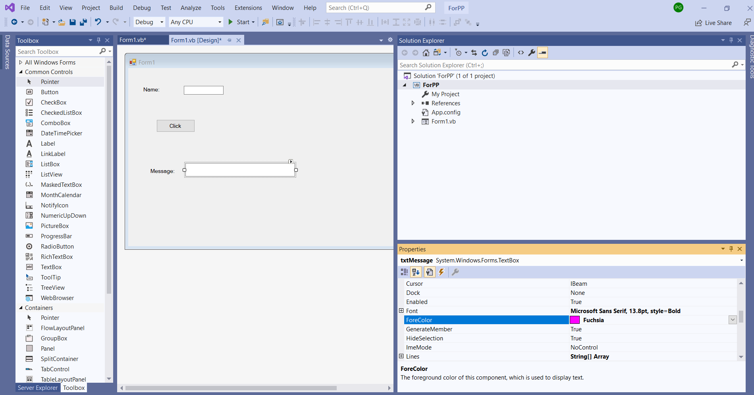
Changing the font, style and forecolor.

Slide 21
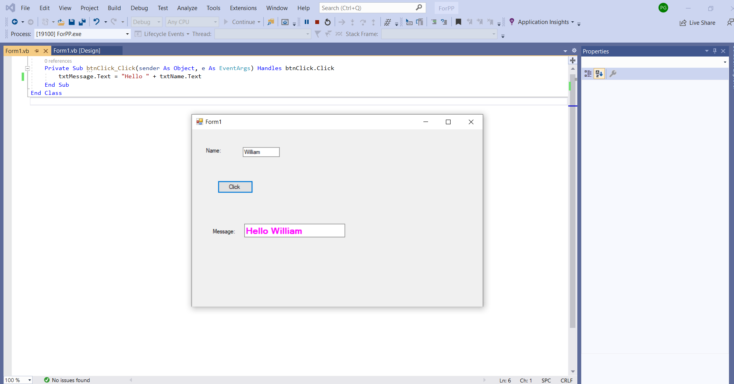

Slide 22
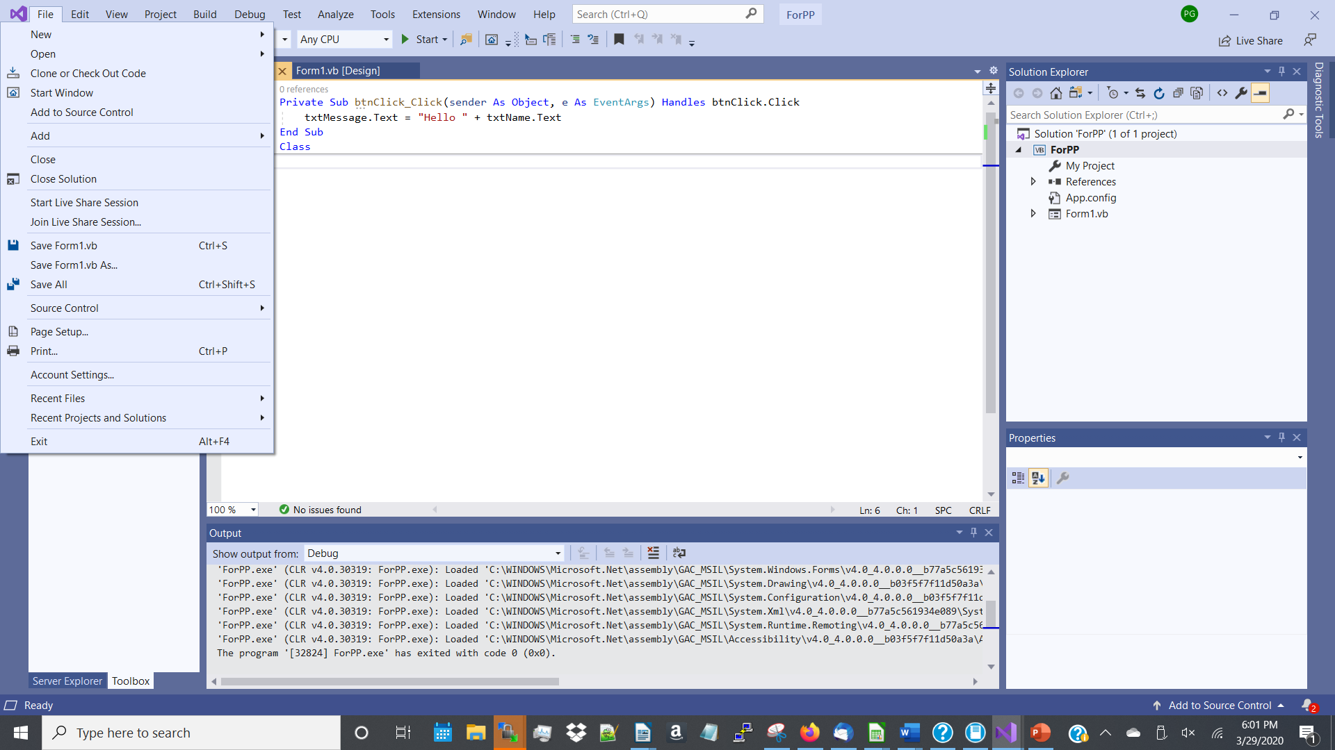
Click on Save All to save your project.
Click on Close Solution to close your project.

