Slide 1
Visual Basic Programs
Decisions, variables and basic processing

Slide 2
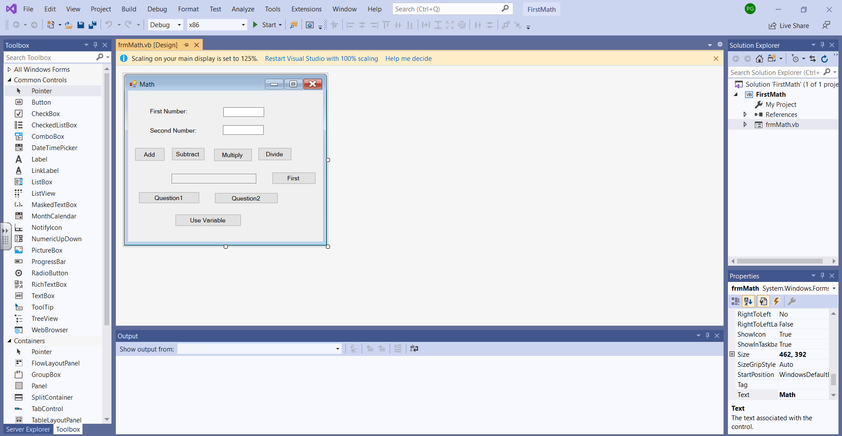
This project is under examples and it is FirstMath.

Slide 3
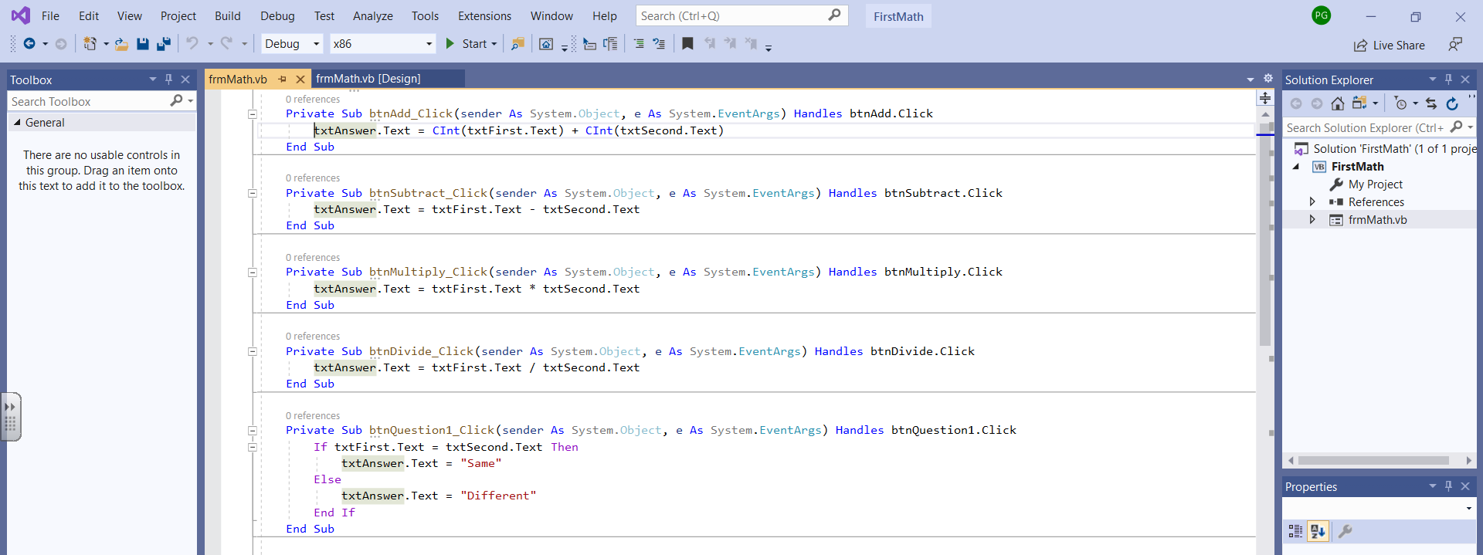
First let’s look at the math. Notice in the btnMultiply_Click event I multiply the text in txtFirst by the text in txtSecond. The text would be what the user entered. Remember that we use the name.Text to get the content. The multiply is done with * and the divide is done with /.
In the btnAdd_Click event the add has to be done differently because the + can mean add and it can meet concatenate (which means put two things together as one). When I want to add, I need to convince VB to do that and I can clarify that the fields should be numeric by using Cint around the field name. Note in the add, I use Cint(txtFirst.Text).

Slide 4
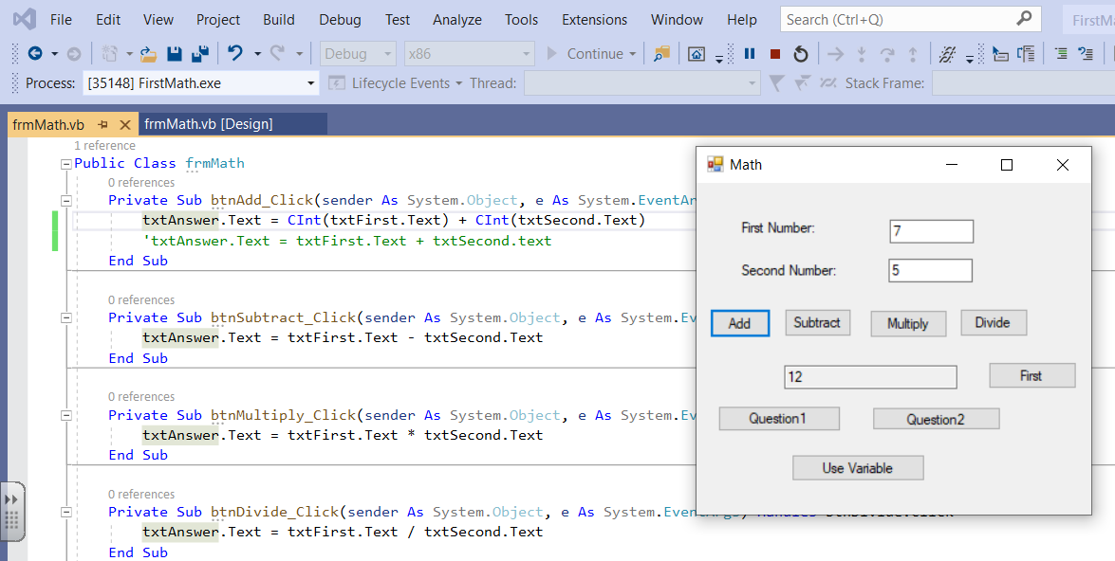
Note that I have added another add statement without the Cint(). Right now it is commented out with the single quote. On the next slide, I will test it.

Slide 5
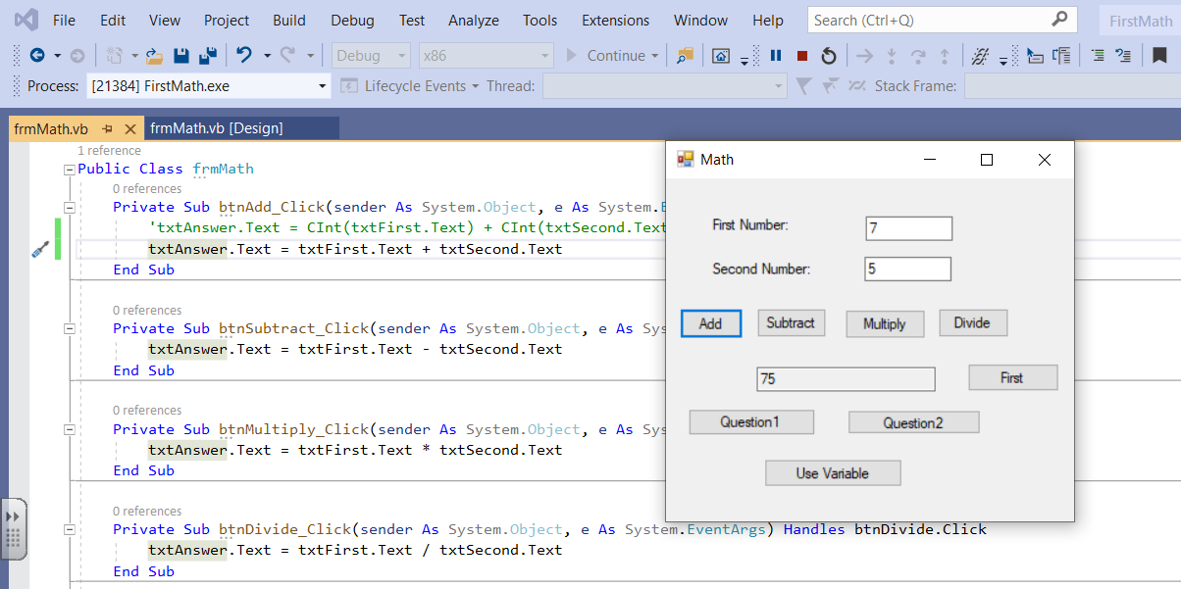
Now the 7 and 5 are concatenated as 75.

Slide 6
Now I have added an IF statement that asks if the answer is greater than 100. If it is, we want to put up a MsgBox with a message.
Note that the MsgBox is similar to the Alert in JavaScript.
The syntax of the if is:
If condition Then
processing you want to do if it is true
End if
The End if terminates the if statement.

Slide 7
No I have added an Else to the if so I can tell it what to do if txtAnswer.text was not greater than 100. Notice the structure and notice the automatic indenting that gets done.

Slide 8
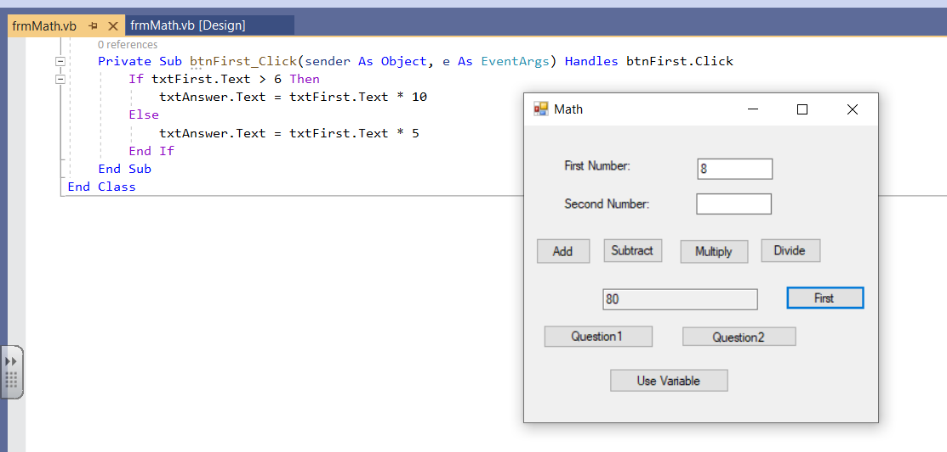
String or text data is stored against the left wall – notice the 8. Numeric data is stored against the right wall. Things entered on the form are considered text or string by default.
I put an 8 in txtFirst.text and now I am comparing to 6. If what I entered is greater than 6 then I multiply by 10 and get 80. Notice that I added the btnFirst_Click. This works but since text entered on the form is string data it would be better to convert txtFirst.Text using Cint or some other method. Then I would be comparing a number to a number which is always best. I will do that by putting in another button. Note that Cint means convert to integer, there is also CDbl and CDec that deal with decimals.

Slide 9
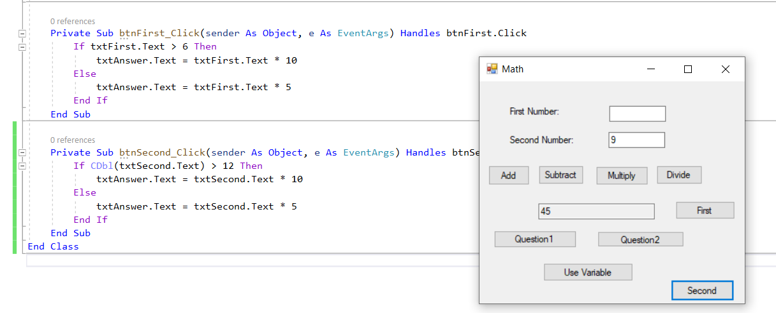
I converted it to Double or Decimal and then did the comparison.

Slide 10
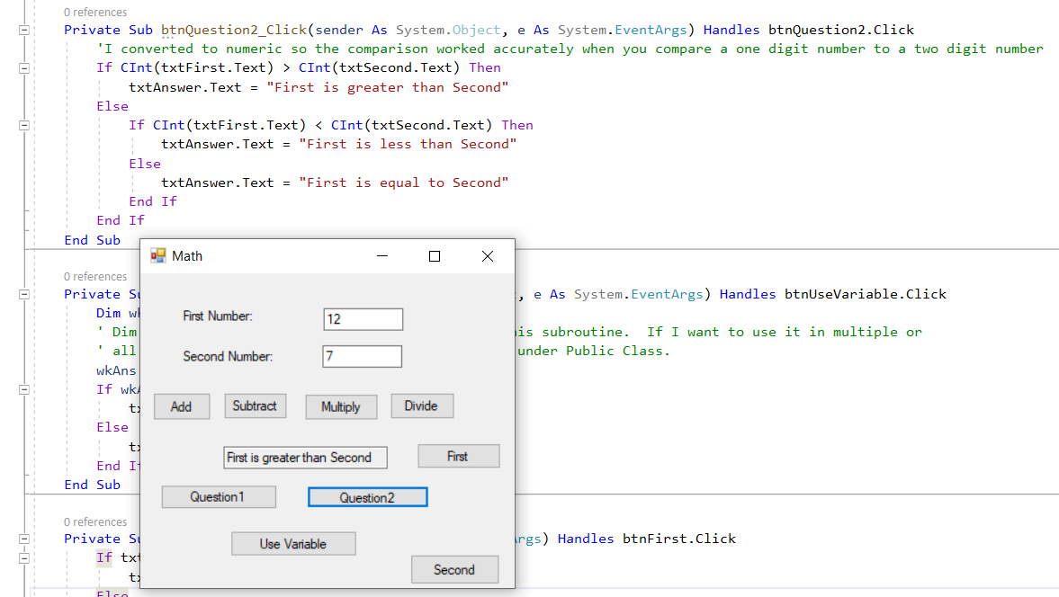
I am now comparing two fields that are numeric. Since they were text fields on the form, I did the conversion.

Slide 11
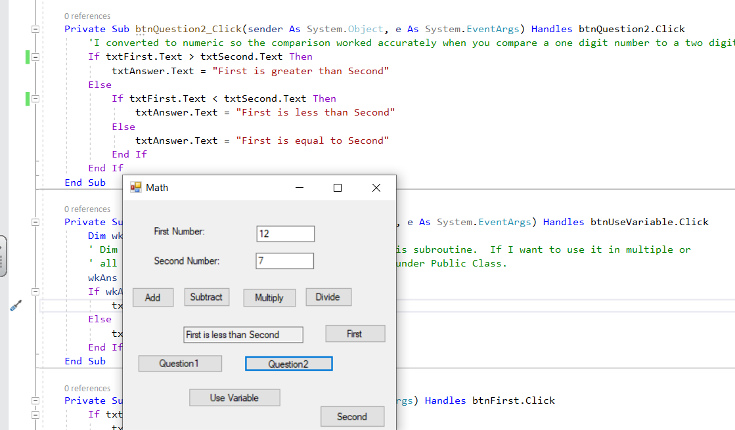
Note that it thinks 12 is less than 7. The reason is that I did not use Cint or CDbl to make them thought of as numbers. So the comparison is between 1 and 7 the first character encountered on the left as text. 1 is less than 7 when you think of it as text.

Slide 12
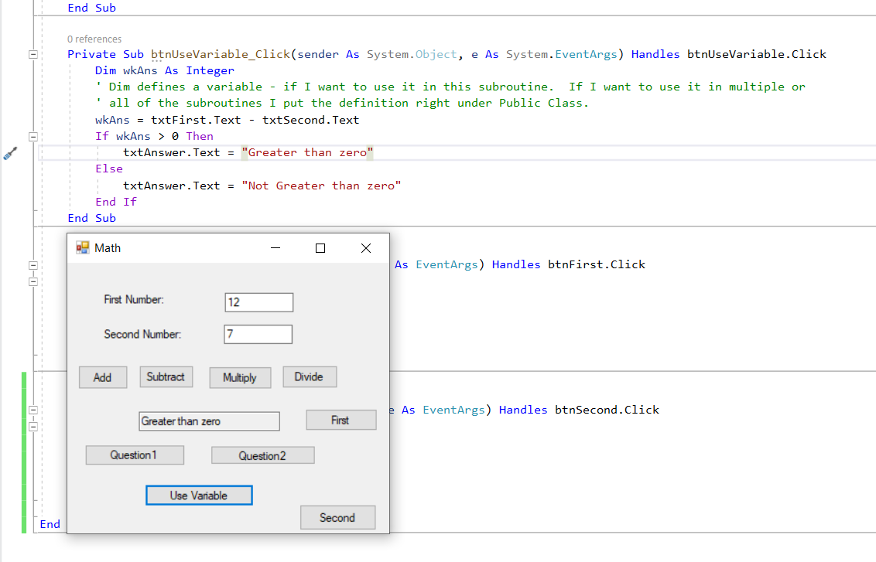
Note that I defined wkAns as an integer which means it is numeric. I can them test it as a number.

Slide 13
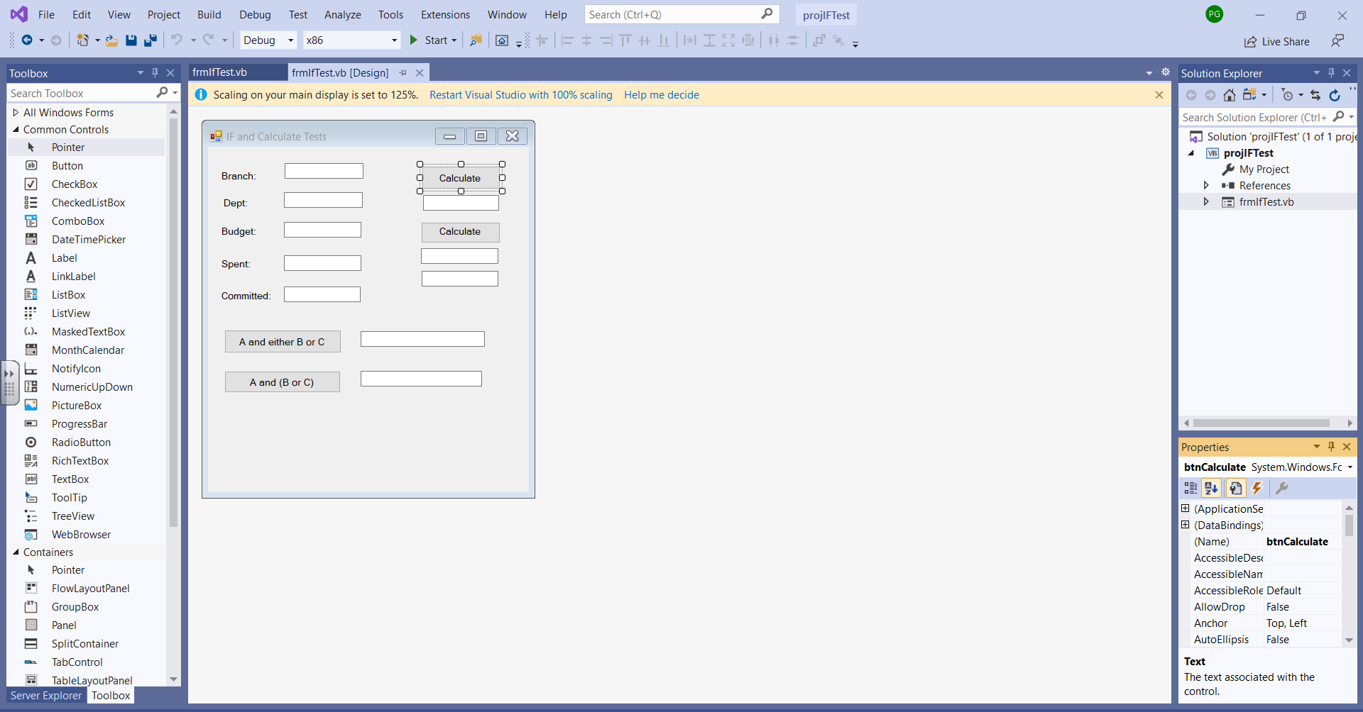
This is the project called projIFTest which is located in the zipped folder NextVB.zip under programs Visual Basic.

Slide 14
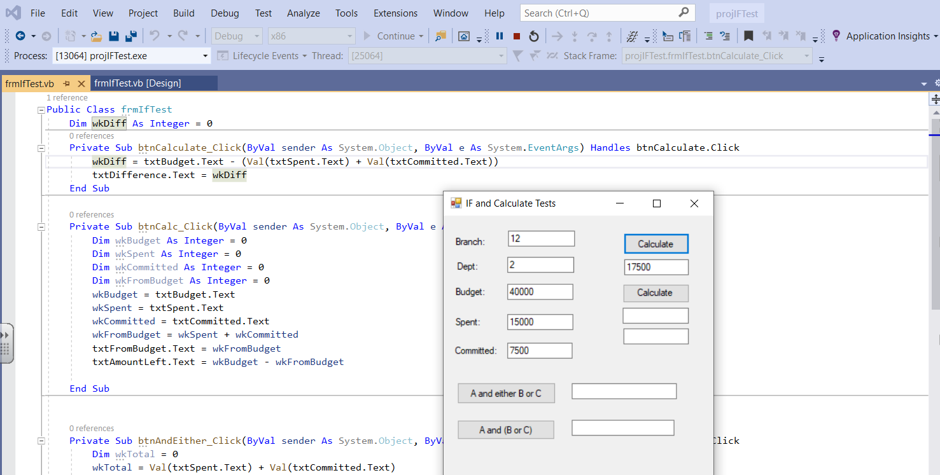
wkDiff is right after PublicClass and is a global variable available to all subroutines.

Slide 15
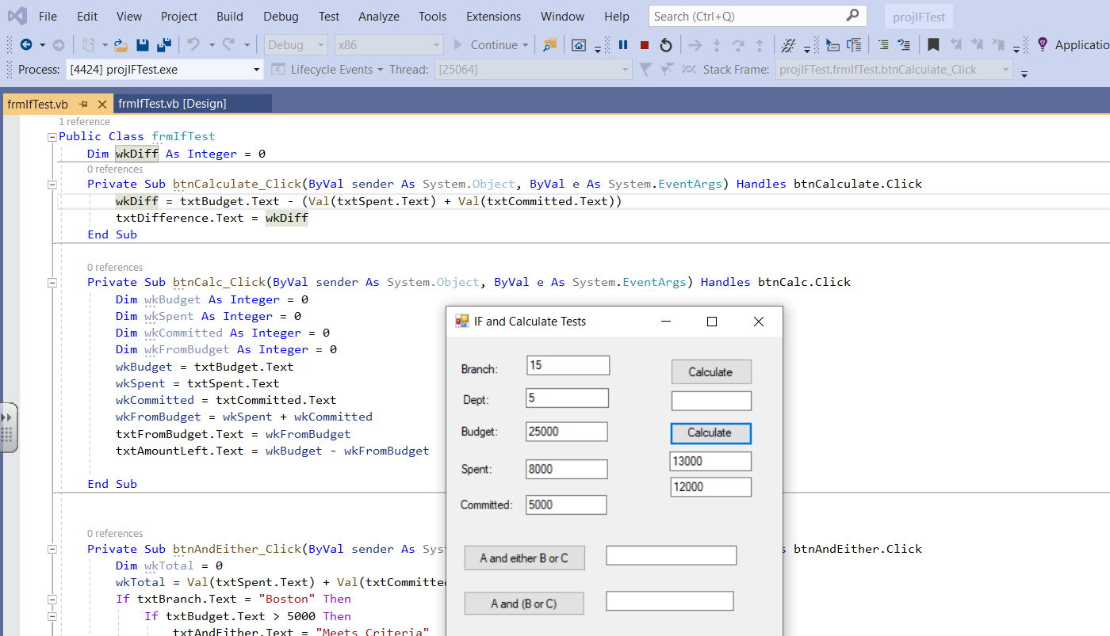
This is probably an overuse of variables but it shows how they can be used.
Variables defined in a subroutine are local variables and only available in that subroutine.
Note that variables have a type and can be given an initial value.

Slide 16
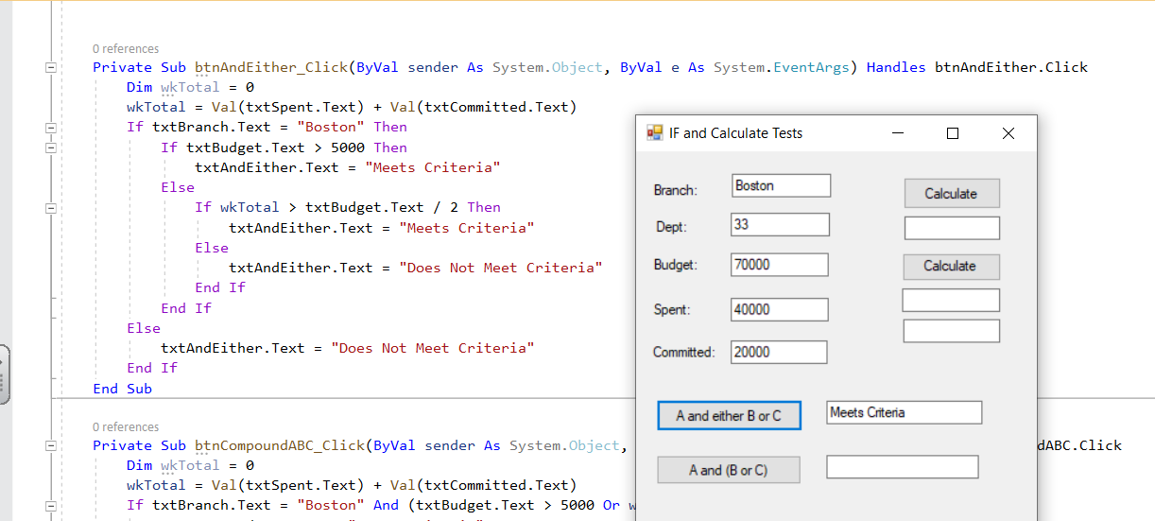
This is a nested if that meets the criteria of one thing having to be true and either of two other things. The branch has to be Boston and then either txtBudget.text is greater than 5000 or wkTotal (which I define and calculate in the subroutine) must be greater than txtBudget.text divided by 2. This is done with simple ifs. The next slide will show a single compound if.

Slide 17
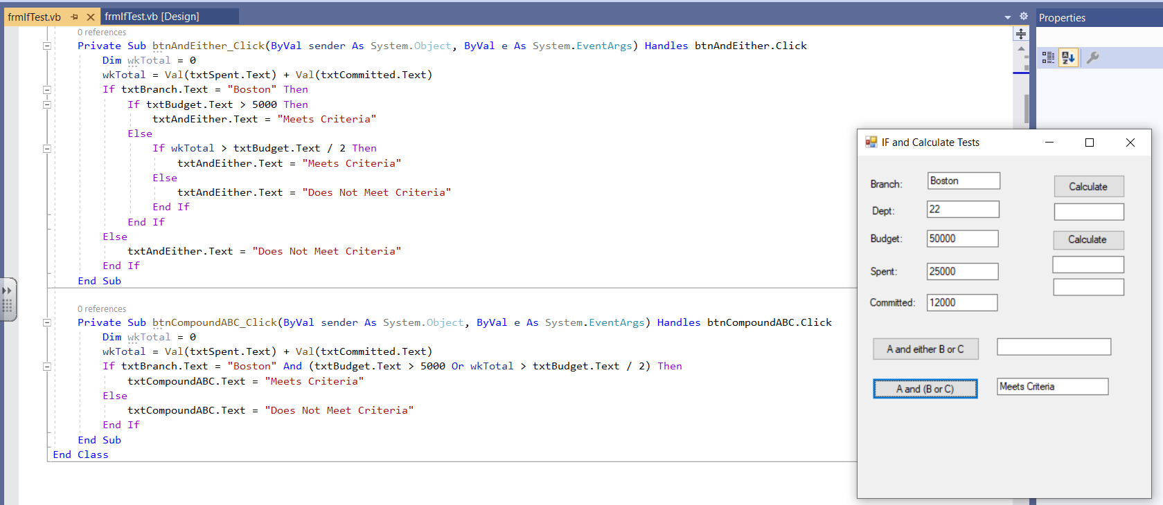
In this one, I am using parenthesis to make sure the or gets dealt with and that Boston has to be true. It is written as Boston and then either of the other two tests and again they are enclosed in parenthesis to make sure that they are resolved first and at least one of them has to be true. So it is Boston and one of them.

