Slide 1
Calculate Total
This is a problem on a form where the user enters information and calculations are done to show the answer. I will show multiple solutions.

Slide 2
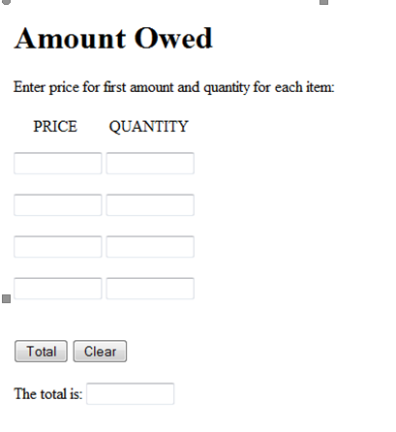

Slide 3
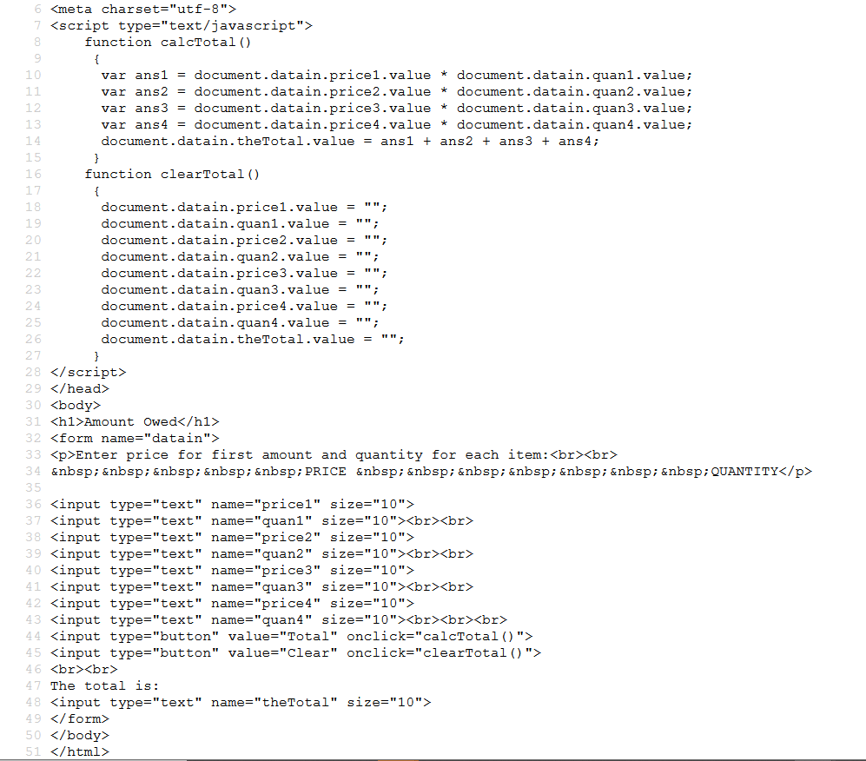
I am first calculating ans1 so I use the address for each of the fields to do the calculation. I refer to the fields as document.form name which is datain.field name.value. For example:
document.datain.price1.value
After we do the four calculations, I added the four
Answers and stored them in
document.datain.theTotal.value
Notice that this is the address where theTotal is located.
Again, data was not passed. A better solution would include passing.
This is the form I set up. Its name is datain. I have set up input type fields where I can enter the price and the quantity 4 times in different fields. If I click on Total then the onclick event will call calcTotal() and if I click on Clear I will call clearTotal(). I have set up a field with the name theTotal where I will put the answer.
Since I did not send data to calcTotal(), I have to use the entire address.

Slide 4
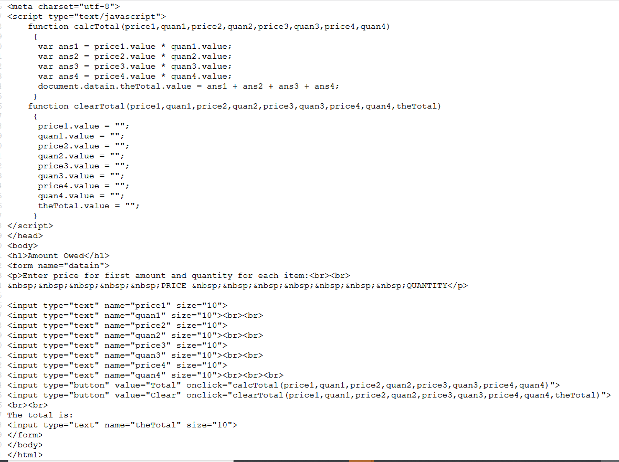
I am sending the names of the fields where the data is stored. So I receive the data and use the value to do the calculations.
Then I calculated theTotal and assign it to
document.datain.theTotal.value. I had to give the complete address for the answer.

Slide 5
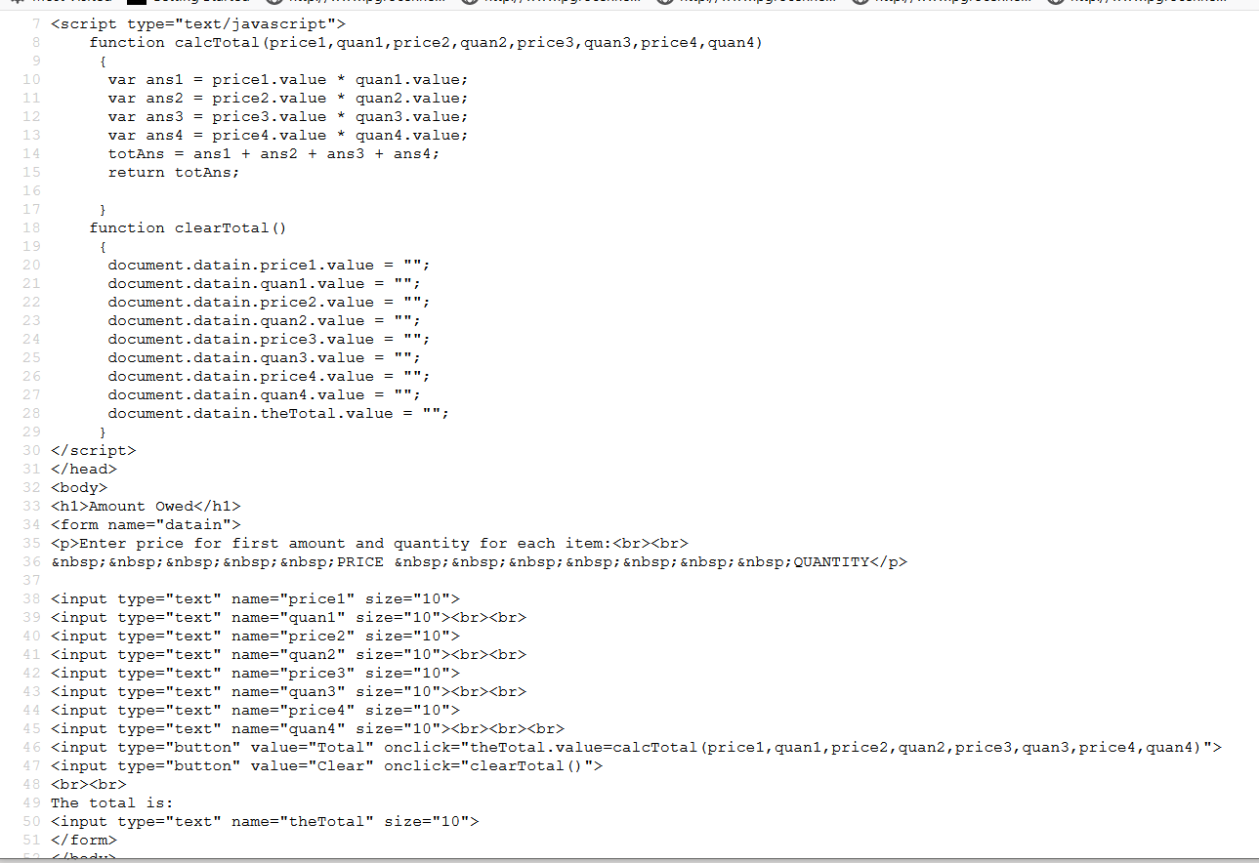
The onclick event send the data. The structure also sets up theTotal to be assigned the data that the function returns. The function returns the content of the totAns.

Slide 6
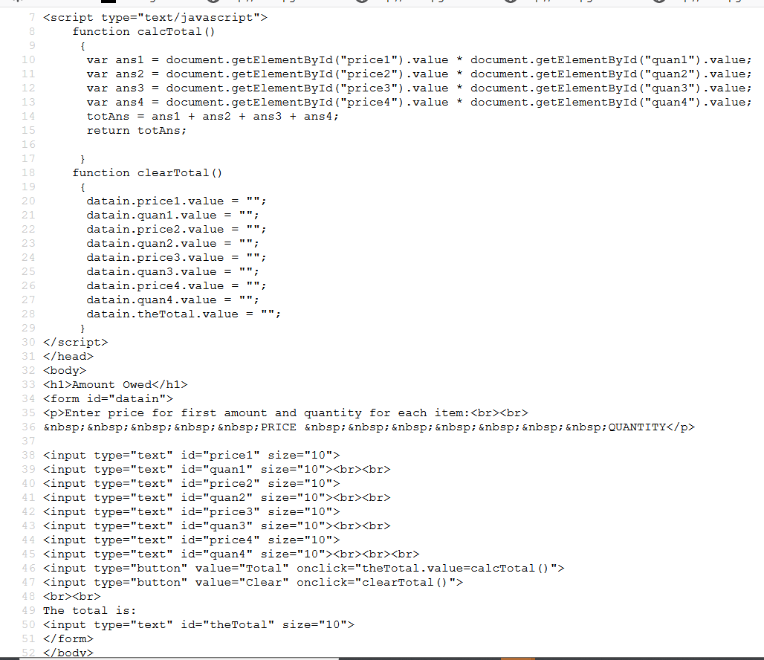
This is using getElementById to get the information.
The return is being assigned to the field called theTotal on the form.
An alternate way to clear the data from the form is
<a href="javascript:location.reload(true)">Refresh this page</a>
Here the totAns that is returned becomes the value of the input type text called theTotal.

