Slide 1
Checkbox or RadioButton
Examples of check boxes and radio buttons

Slide 2
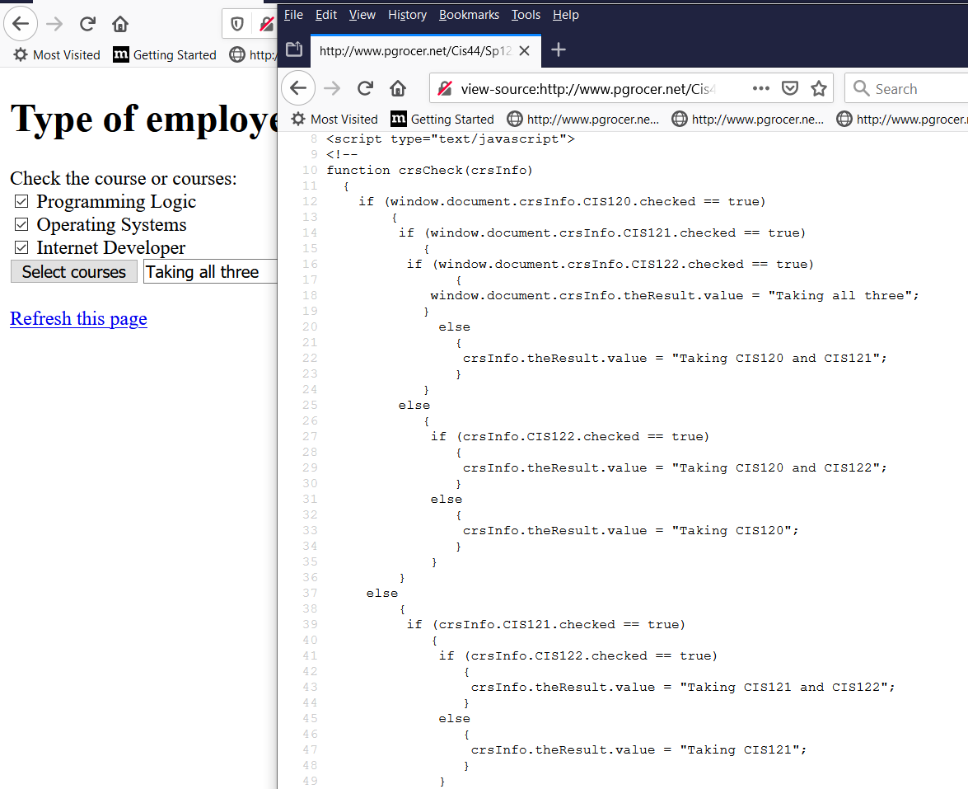
I am checking each of the check boxes using a complete address and then using .checked == true to determine whether the boxes are checked. The first set of three checks got true to all and therefore got the message Taking all three. If the last one was not checked I would get the message that CIS120 and CIS121 were checked. Bring up the entire script to see it completely. Continued on next page.
http://www.pgrocer.net/Cis44/Sp12JS/checkboxCrs.html

Slide 3
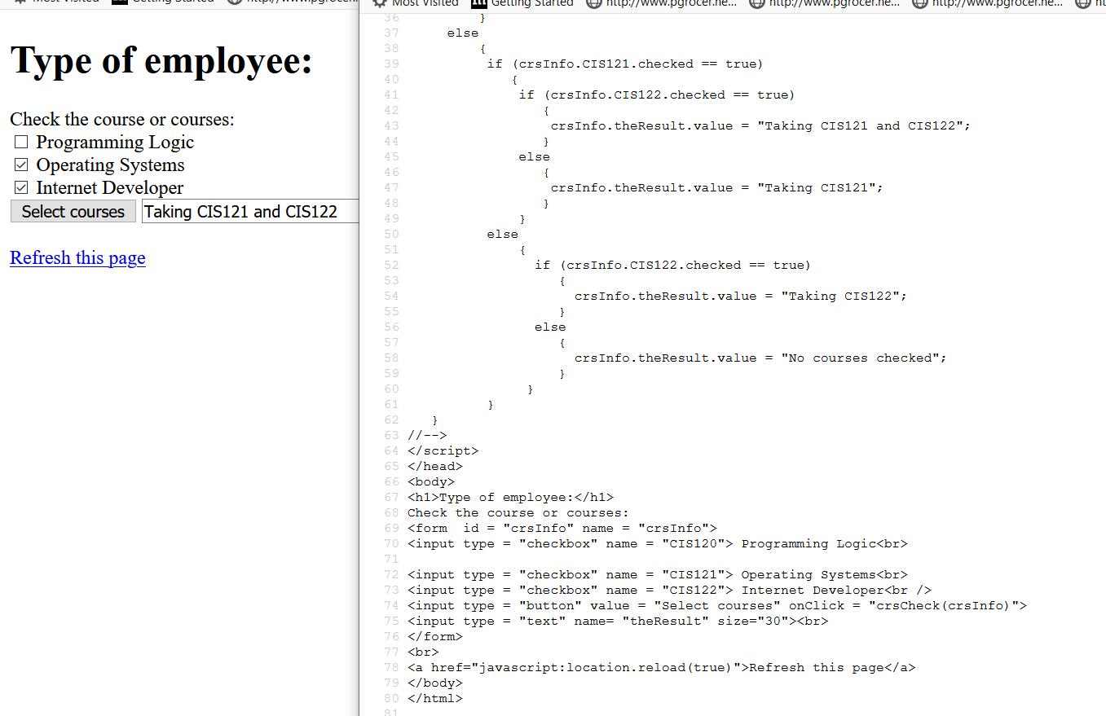
Note that on the form I have set up type checkbox and given each a name.
In the if statement I refer to crsInfo which is the name of the form.CIS122 which is the name of the checkbox .value.
The Refresh this page line is a way of clearing boxes – check out how it works
I have used id and name to give the form the name of crsInfo and I then send crsInfo to the function. That means it only has to use the address to tell what in crsInfo is being tested or receiving information etc.

Slide 4
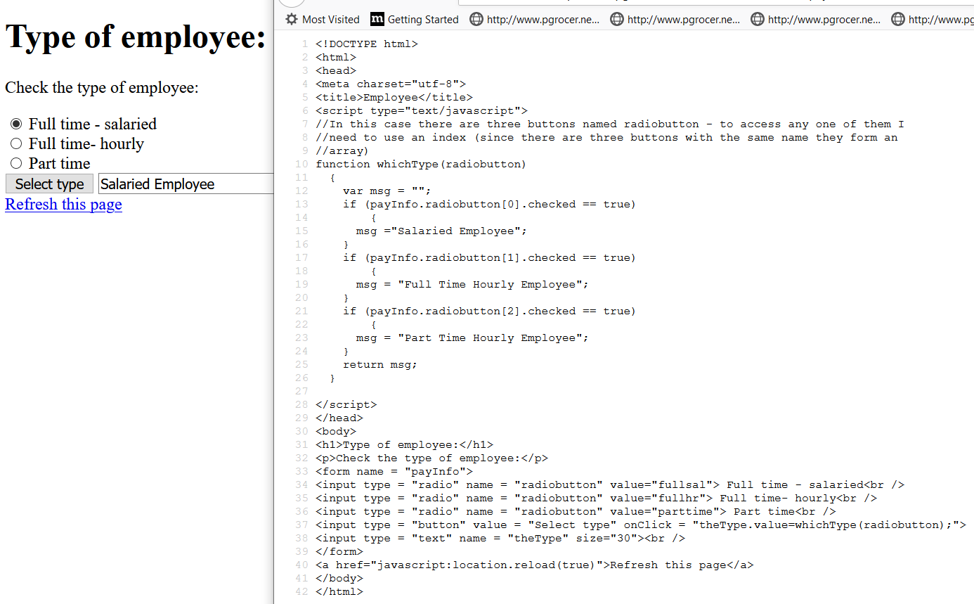
On the form I gave each radio button the name of radiobutton. However three things cannot have the same name, so I now need to use an index to specify which of the three I am referring to. The first one is radiobutton[0] and the second one is radiobutton[1].
Giving each button the same name groups them which means only one button can be clicked. If I want another group, I can give the buttons in that group a different name.
Also note that when I call the function, I sent the name.

Slide 5
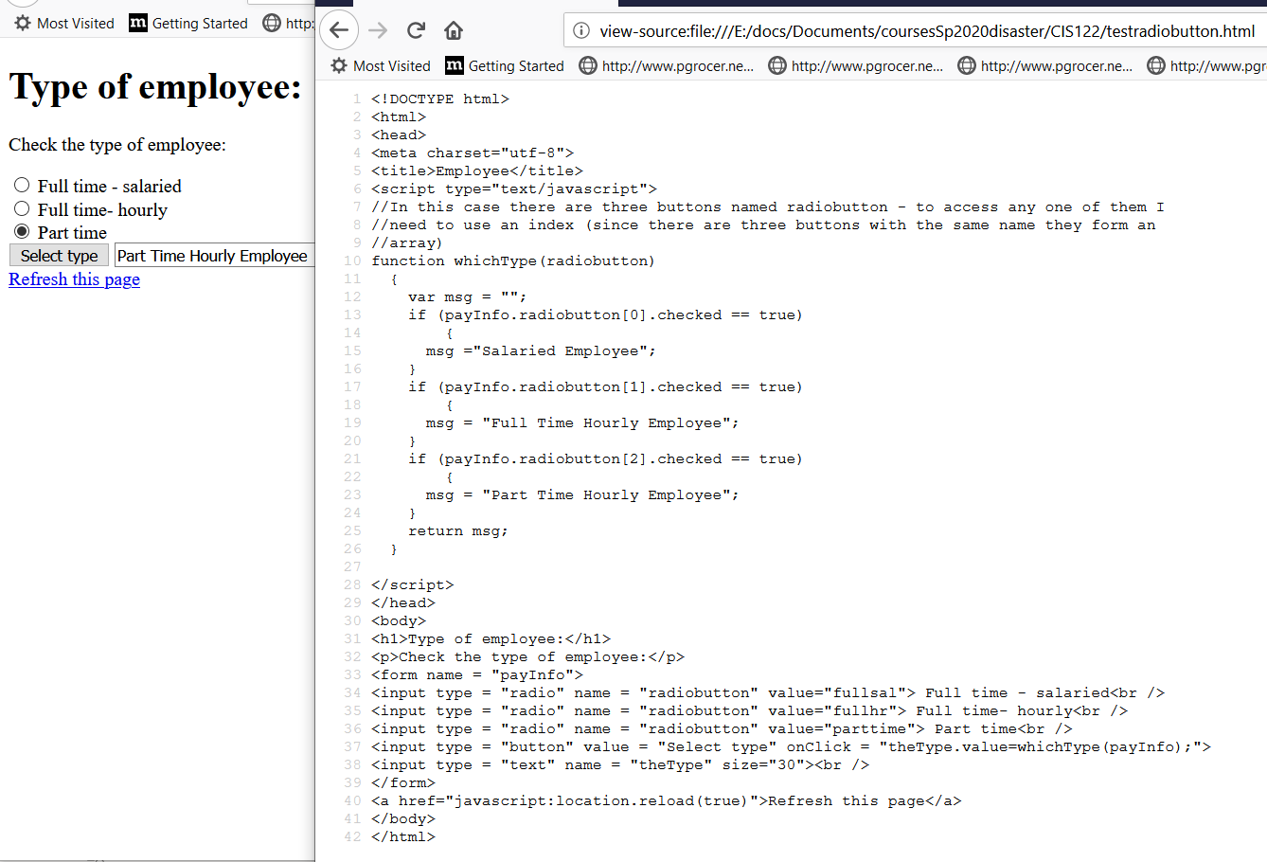
On this one I sent payInfo instead of
radiobutton.

Slide 6
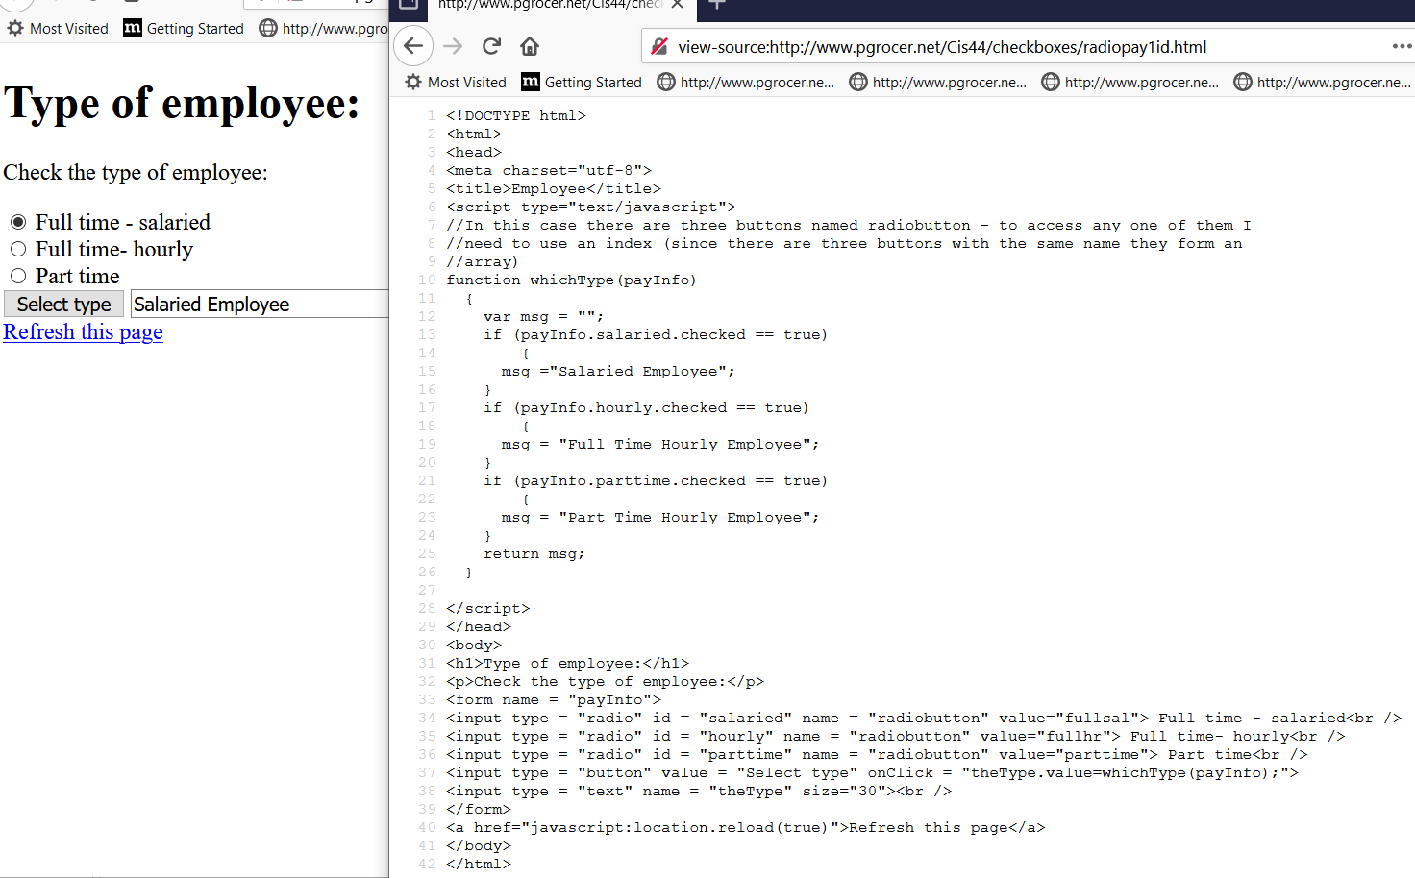
In this example each radiobutton has the same name. This is to tell the browser they are in a group and only one can be checked.
I also give each one an id that is unique. Therefore in my if statements, I can check using the id.
So the name forms the group and the id refers to individual buttons in the group. I do not need an index for this example.
In this one, when I called the function, I sent in the form name which is payInfo.

