Slide 1
DOM
Some DOM examples – I selected some examples so be sure to notice the name of the script – most are in order with some skipped but a few are out of order.

Slide 2
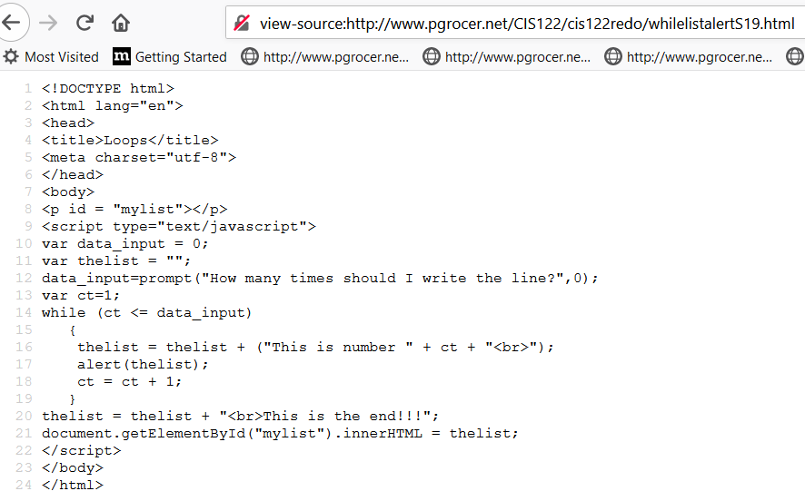
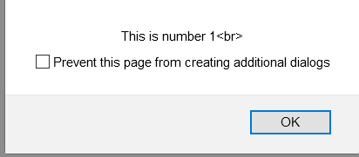
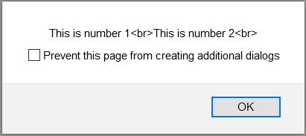
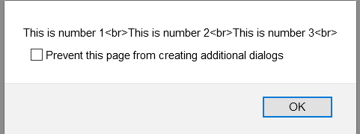
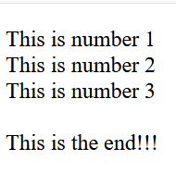
Each pass through the loop I take what was in thelist and concatenate information saying This is number and give the content of ct plus a break to the next line. Then just so you can see where I am I put out an alert.
When the loop is complete I add a phrase about being at the end and I put thelist into the paragraph with the id of mylist.

Slide 3
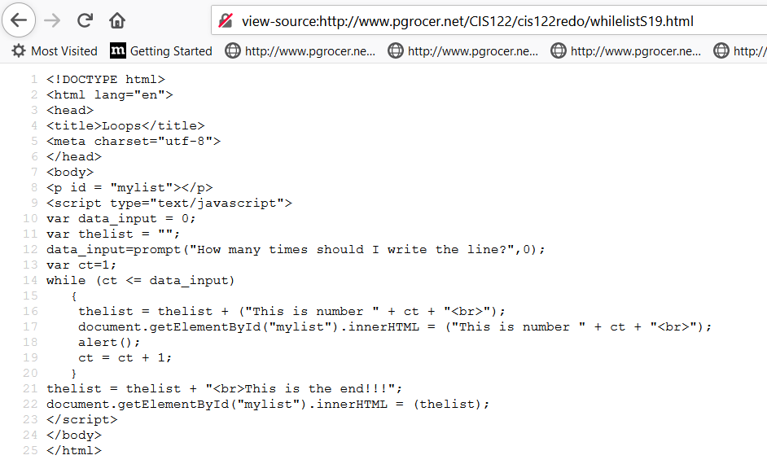
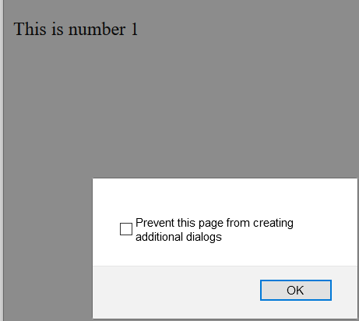
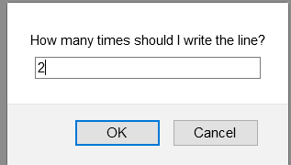
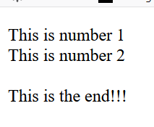
I like the one with the alert better, but this one shows you the step by step as well although notice the overwrite.

Slide 4
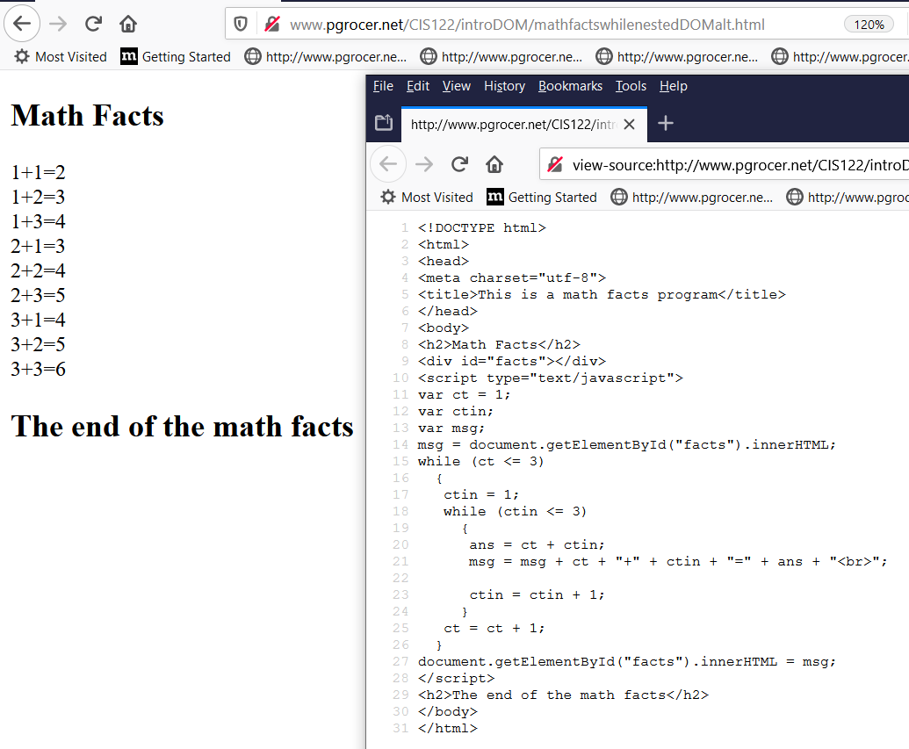
Note that msg is always equal to what is already in msg + the new math fact I am adding.
At the end of the loop, msg contains all of the math facts and is written out.

Slide 5
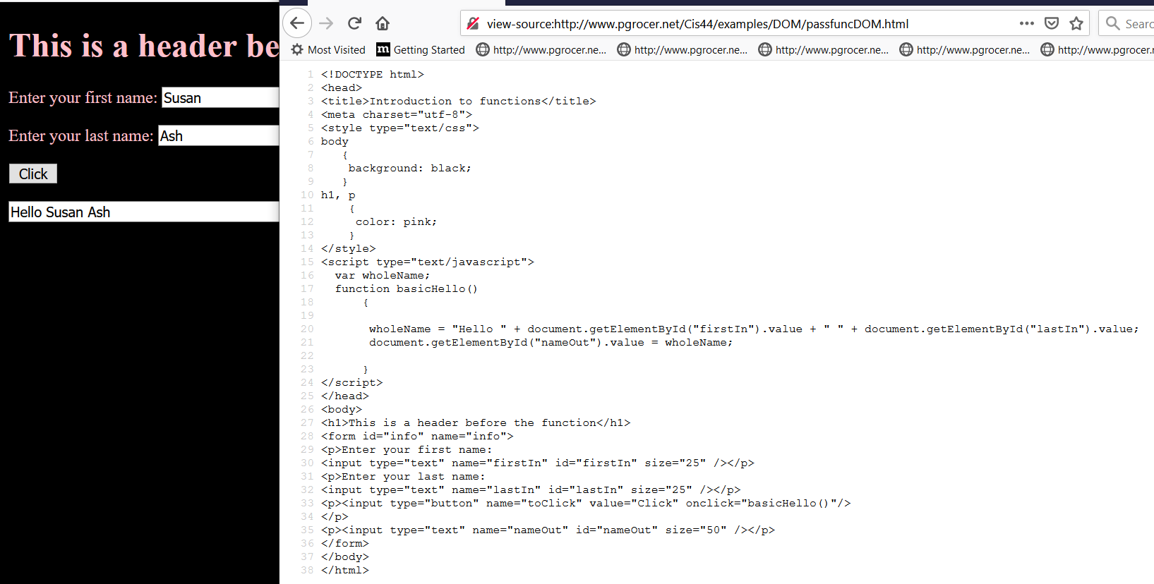
Note the use of value since you need to specify that it is the value property of the box you want.
The element on the form has an id which is used by getElementById to locate the data.

Slide 6
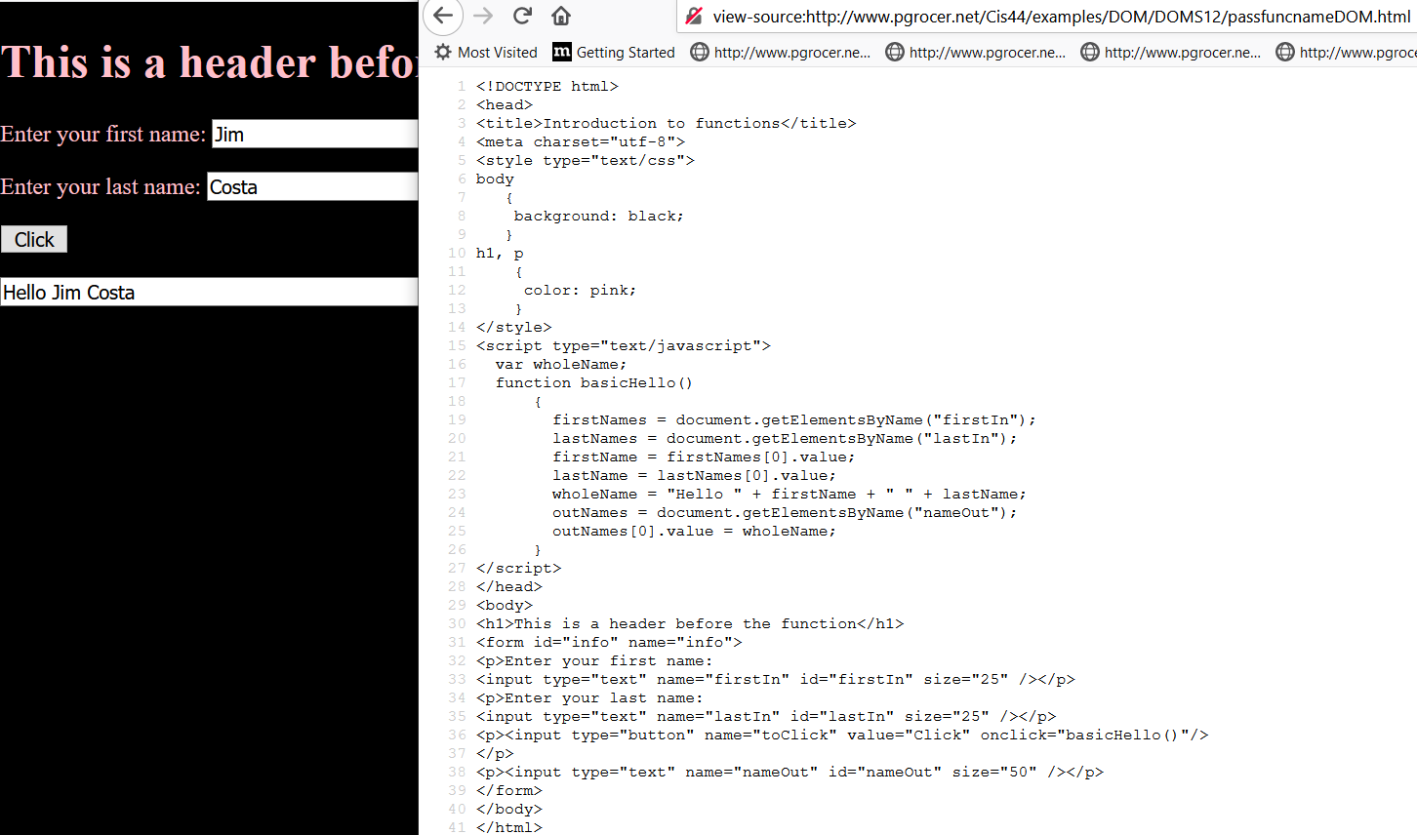
Note that I am now using getElementByName which can get multiple returns. They are ordered in a behind the scenes array and I need to use an index to specify which name. I this example there is only 1 and I use the index of [0].

Slide 7
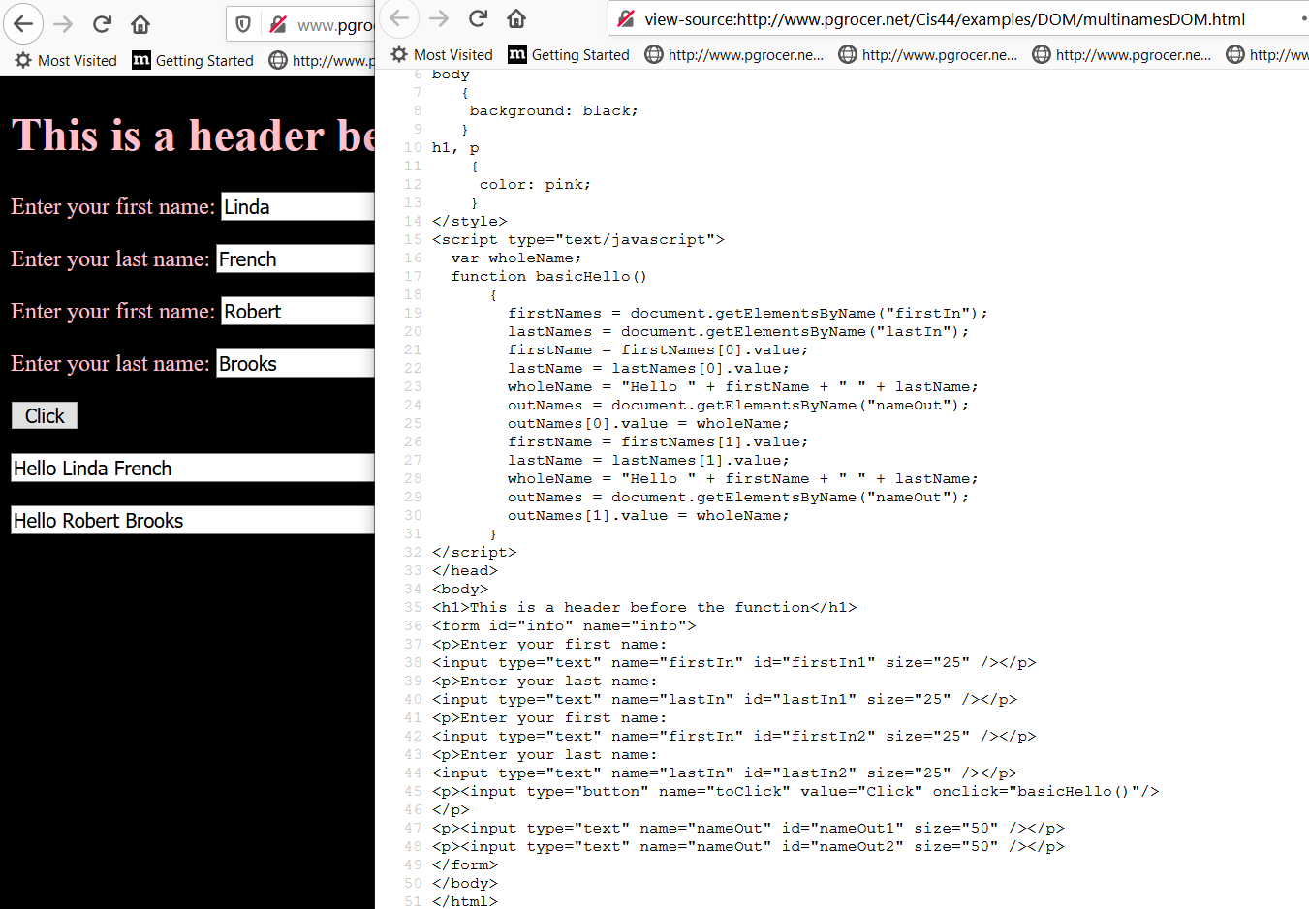

Slide 8
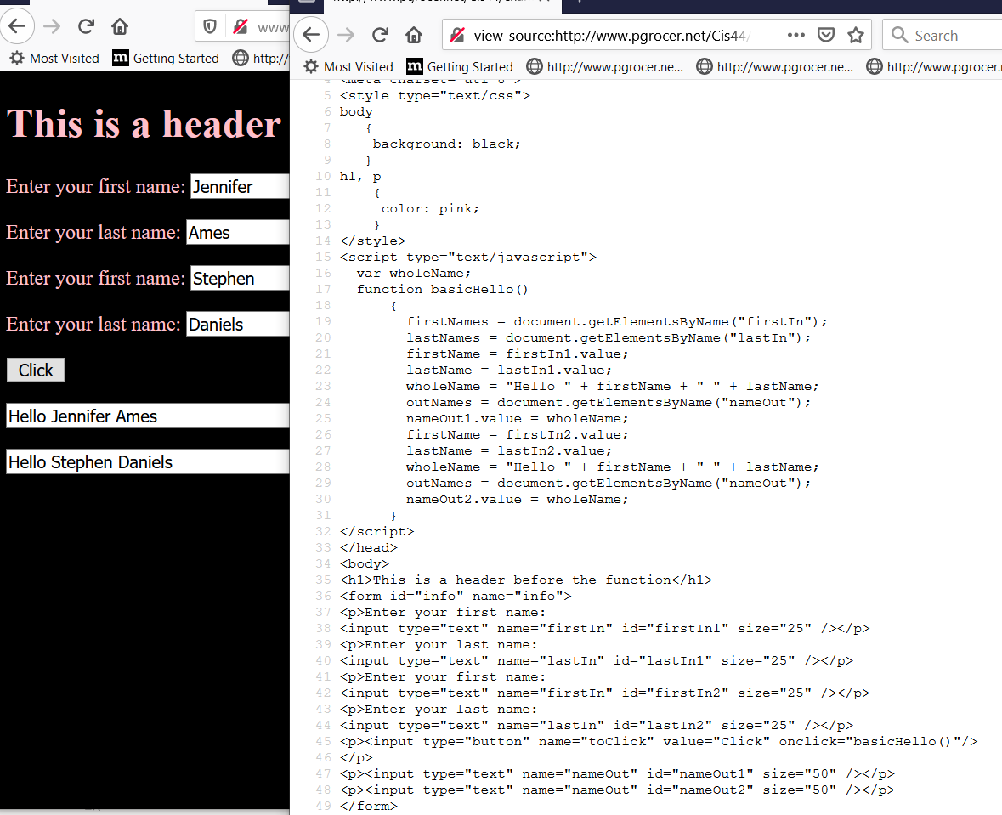
http://www.pgrocer.net/Cis44/examples/DOM/multinamesDOMid.html
Note that I am not using the index here because I used the id to give each one a unique name. The name identified the group as in firstIn and the id gave a unique name to all of the ones in the group such as firstIn1.

Slide 9
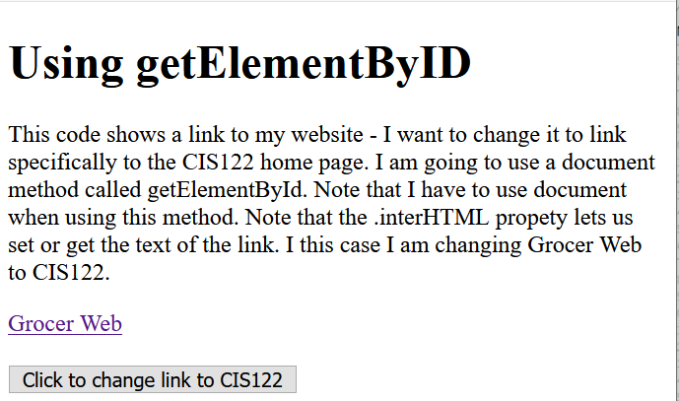
http://www.pgrocer.net/Cis44/examples/DOM/DOMF13/getbyID.html
Code on next slide.

Slide 10
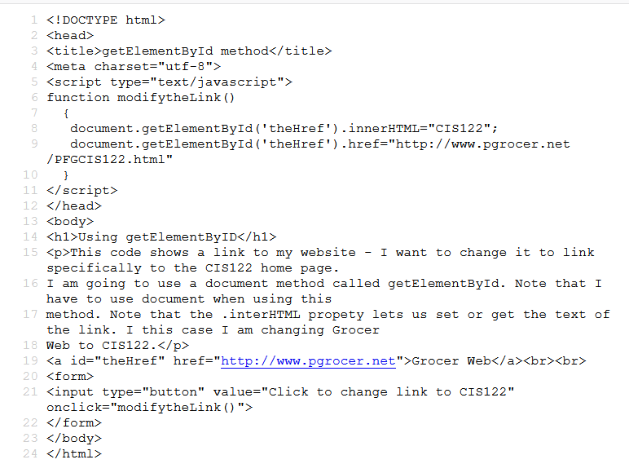
This line has an id of theHref and the function at the top will change the innerHTML to read CIS122 instead of GrocerWeb and it will changed the .href to a new link.

Slide 11
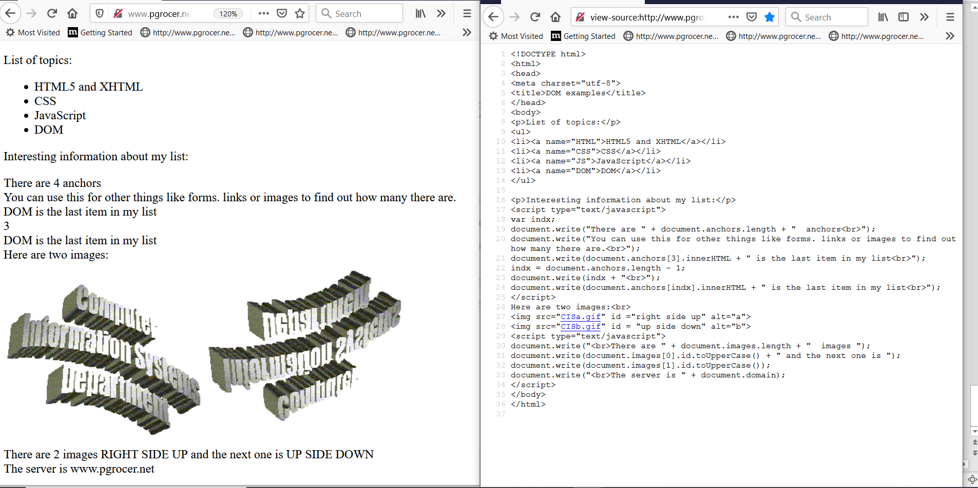
http://www.pgrocer.net/Cis44/examples/DOM/DOMS12/test1.html
Things to notice:
document.anchors.length
document.anchors[indx] to specify a specific anchor

Slide 12
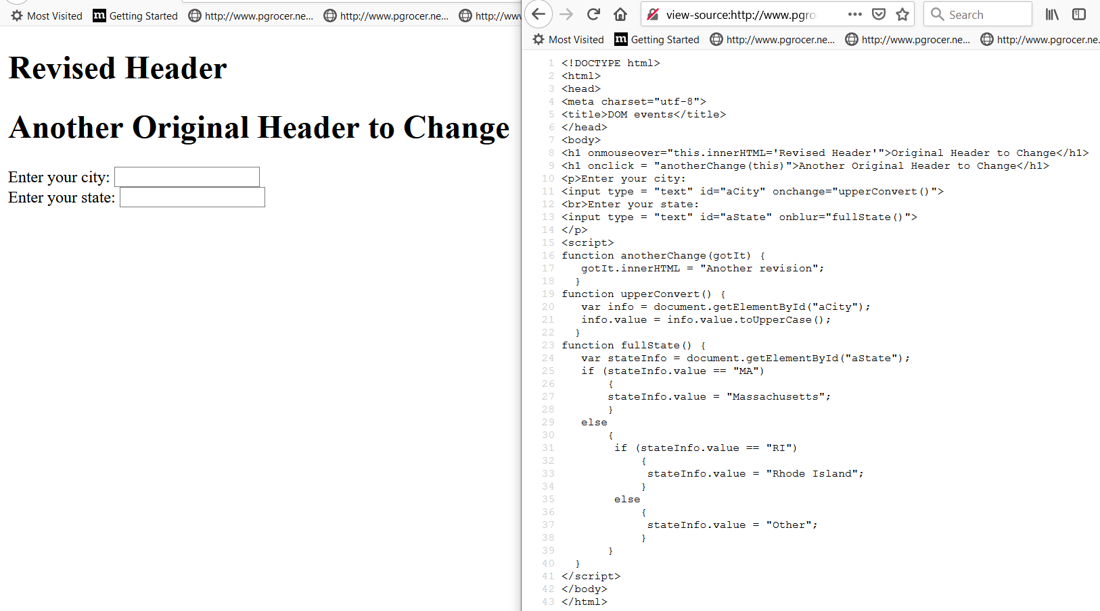
If I put in Hingham it will change to upper case and MA will change to Massachusetts.
http://www.pgrocer.net/CIS122/DOMevent/DOMeventsbasic.html

Slide 13
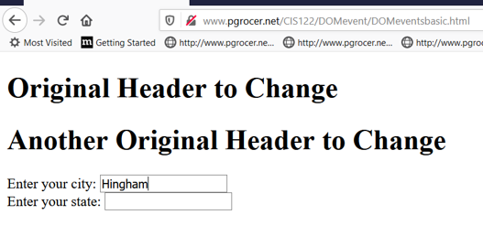
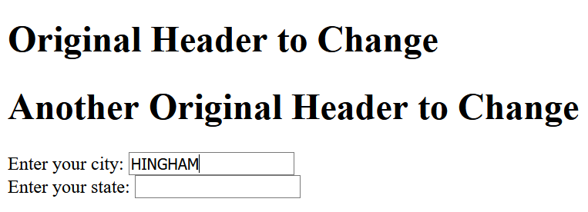
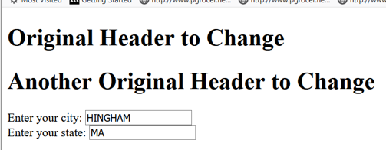

Slide 14
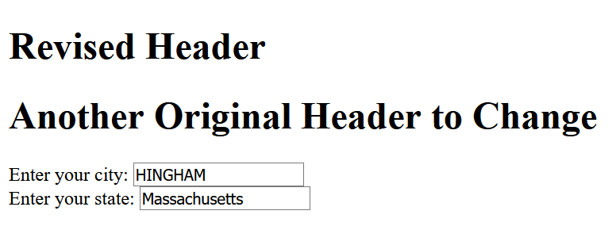
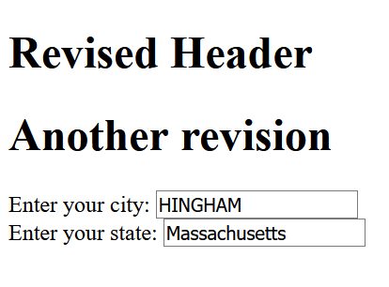
The first header changed with a mouse over. The second header needs a click.

Slide 15
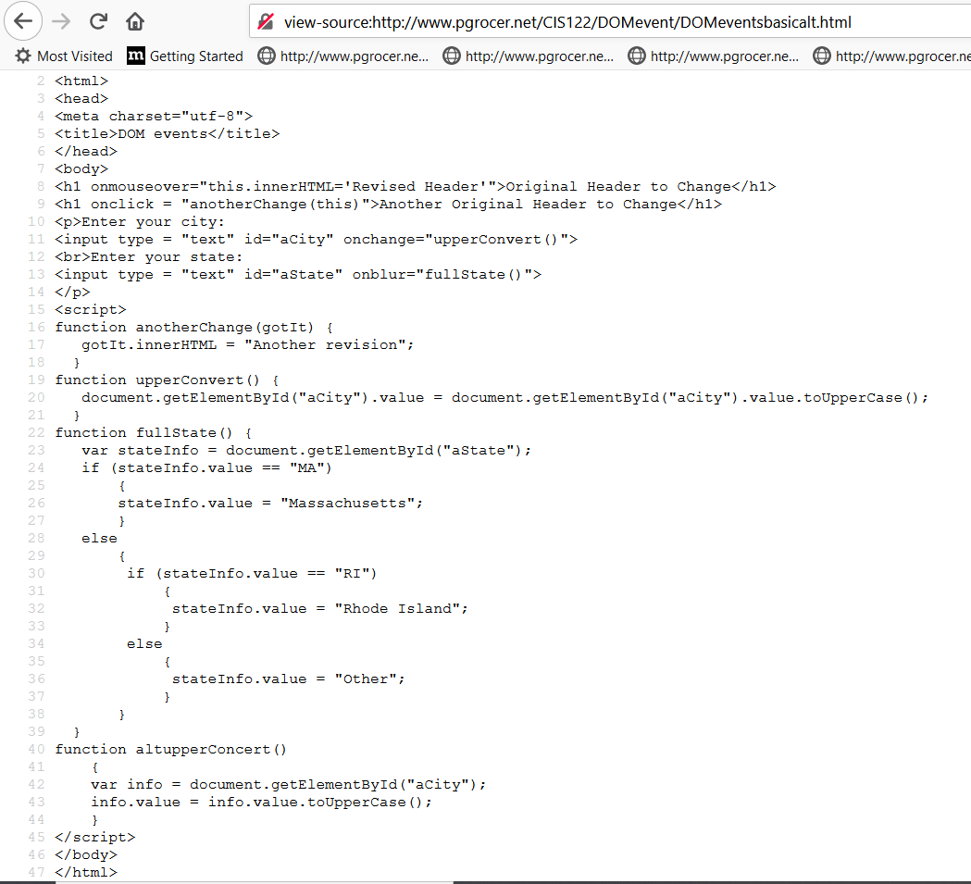

Slide 16
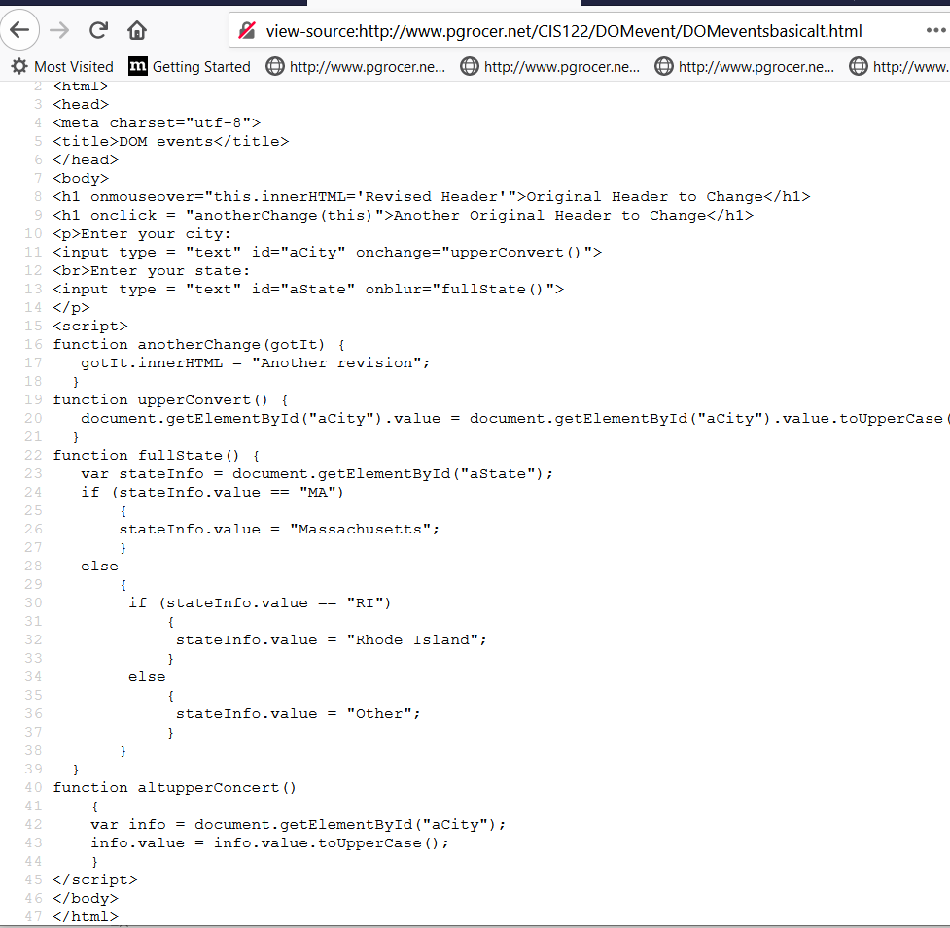
Slightly modified version.

Slide 17
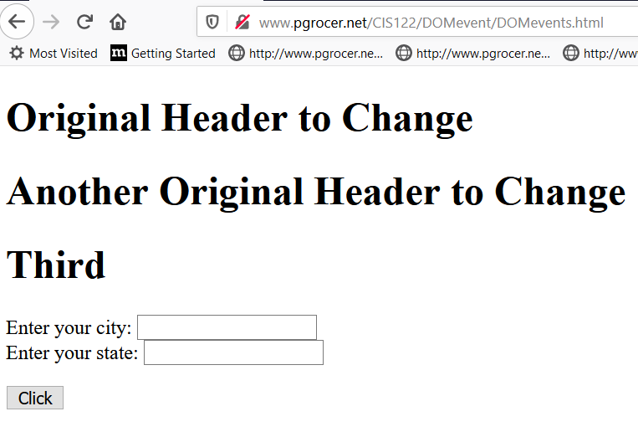
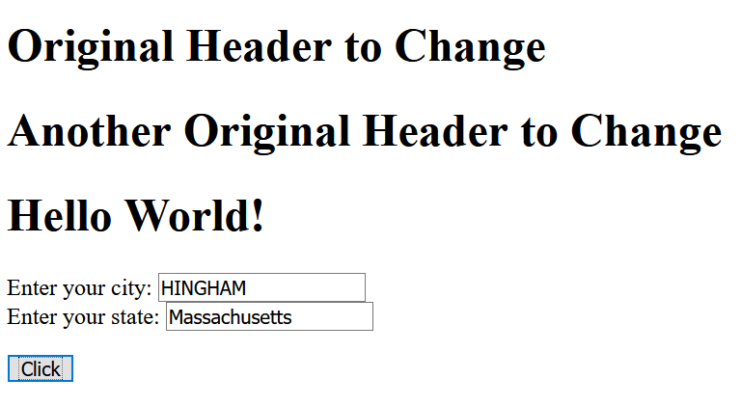

Slide 18
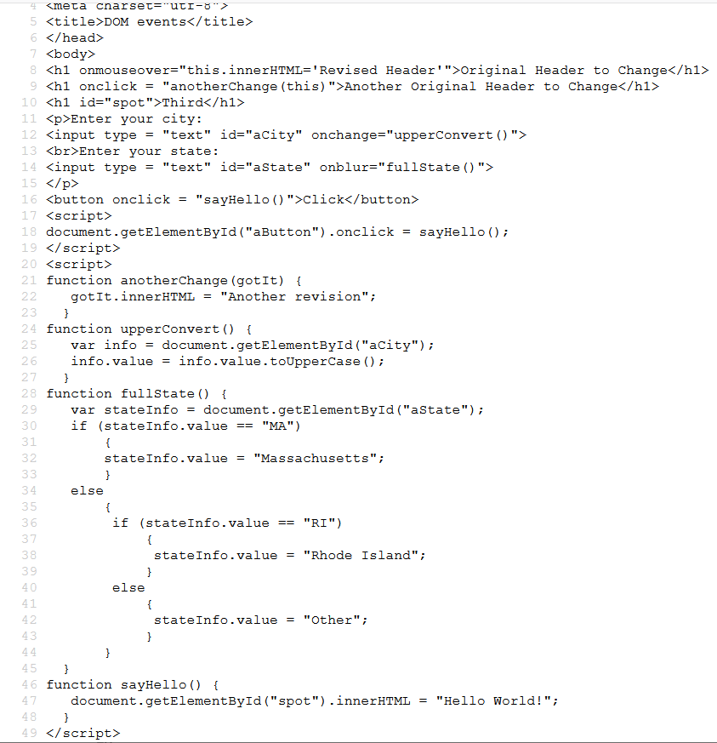
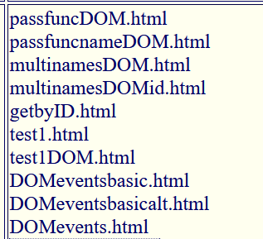
This presentation stops here. Other things will be in the next presentation.

