Slide 1
Functions
Working with JavaScript Functions

Slide 2
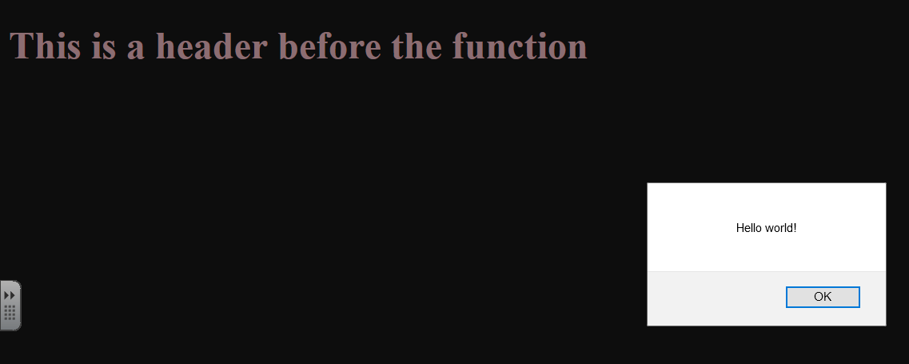
<?xml version="1.0" encoding="iso-8859-1"?> <!DOCTYPE html PUBLIC "-//W3C//DTD XHTML 1.0 Strict//EN" "http://www.w3.org/TR/xhtml1/DTD/xhtml1-strict.dtd"> <html xmlns="http://www.w3.org/1999/xhtml" xml:lang="en" lang="en"> <head> <title>Introduction to functions</title> <style type="text/css"> body { background: black; } h1 { color: pink; } </style> <script type="text/javascript"> function basicHelloWorld() { alert("Hello world!"); } </script> </head> <body> <h1>This is a header before the function</h1> <script type="text/javascript"> basicHelloWorld() </script> <h1>This is a header after the function!</h1> </body> </html>
introfuncx.html

Slide 3
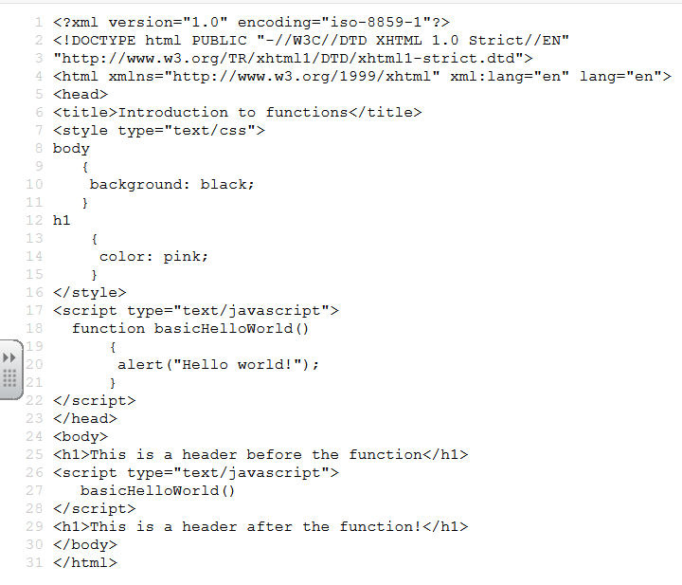
The top 4 lines are the base for XHTML
I have set up a function in the head. It is enclosed in the <script> tag so the browser will know it is a script. It is called basicHelloWorld(). The () are necessary to convey that it is a function. The code to execute inside the function is enclosed in curly braces. When the function is executed,
It will display an alert.
I am in the body and after I put out the header in HTML I drop down and execute the function that is enclosed in the script.
Note that the script simply gives the command basicHelloWorld() which means execute the function of that name.
So it goes out and performs the function and when it is complete it returns and drops down to the next instruction that is outside the script. This is another header.

Slide 4
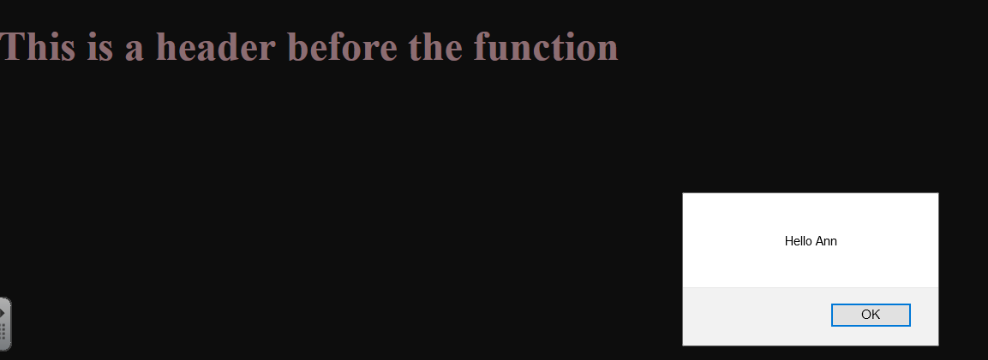
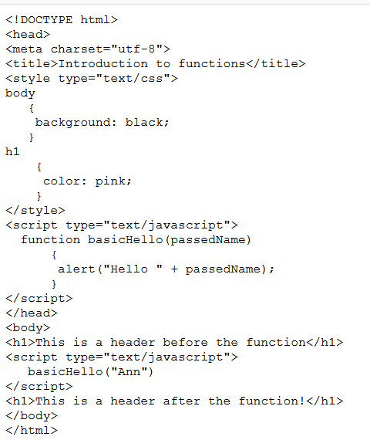
passfunc1x.html – I am calling the basicHello function and sending the literal “Ann”. The function has a name in parenthesis which will receive the literal I pass.
Inside the function I am saying Hello and concatenating the contents of passedName. So I say Hello Ann.
When the function is complete, I return and drop down to the h1 tag and display the header.

Slide 5
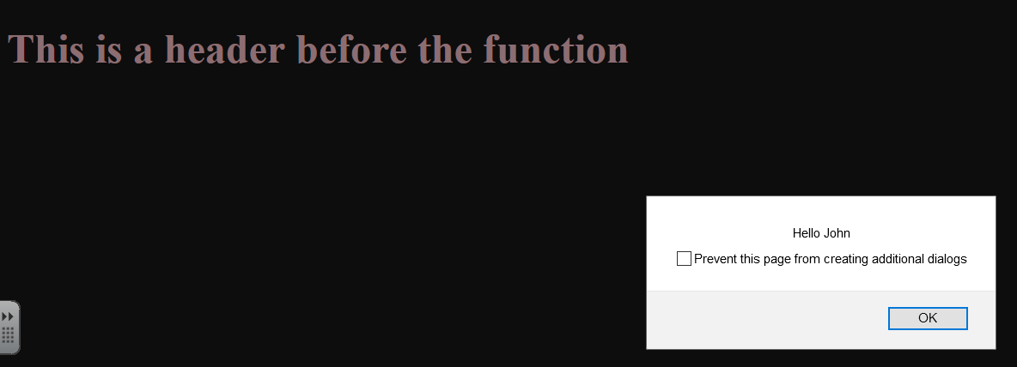
passfunc25.html

Slide 6
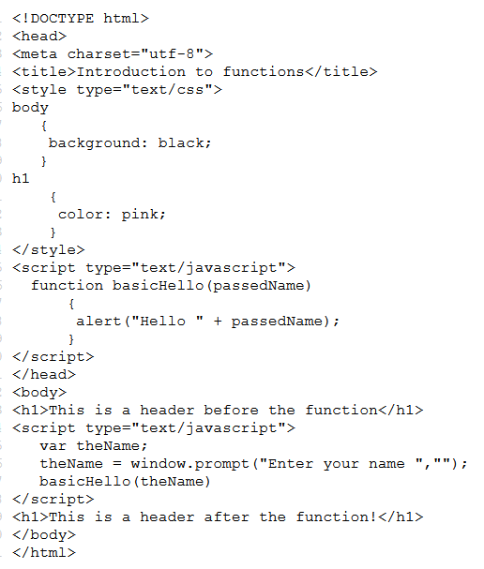
In this example, note that the function is being passed theName and it is receiving the data as passedName. It is acceptable to use the same name for the memory variable or different names.
In this example, the name to be passed is entered in using a prompt. Note that window.prompt() could also have been written as prompt().

Slide 7
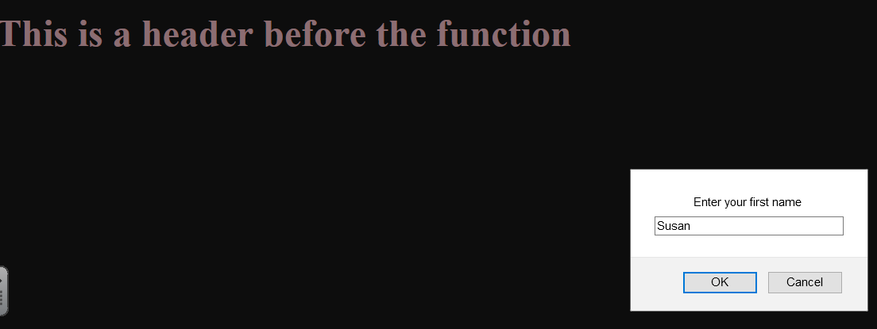
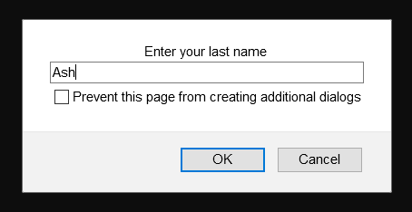
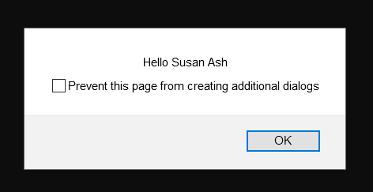
passfunc35.html – after you see the full name and click off you will see the header after the function

Slide 8
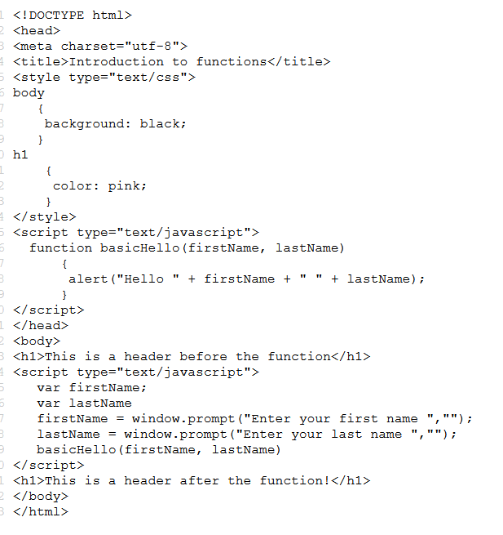
I am passing firstName and lastName. The first thing I sent is received in firstName and the second one is received in lastName. The sending and receiving fields do not have to be the same. It is the order that matters. The first thing sent is the first received.

Slide 9
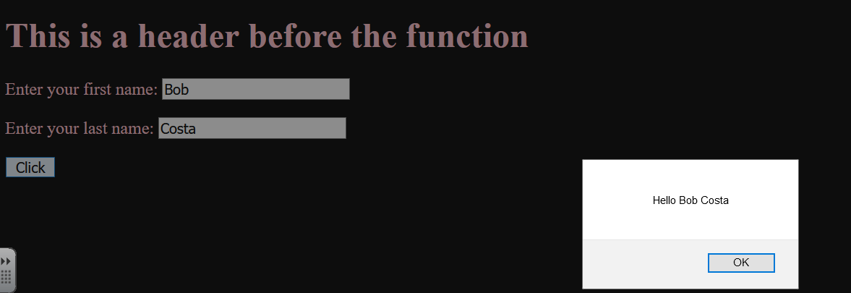
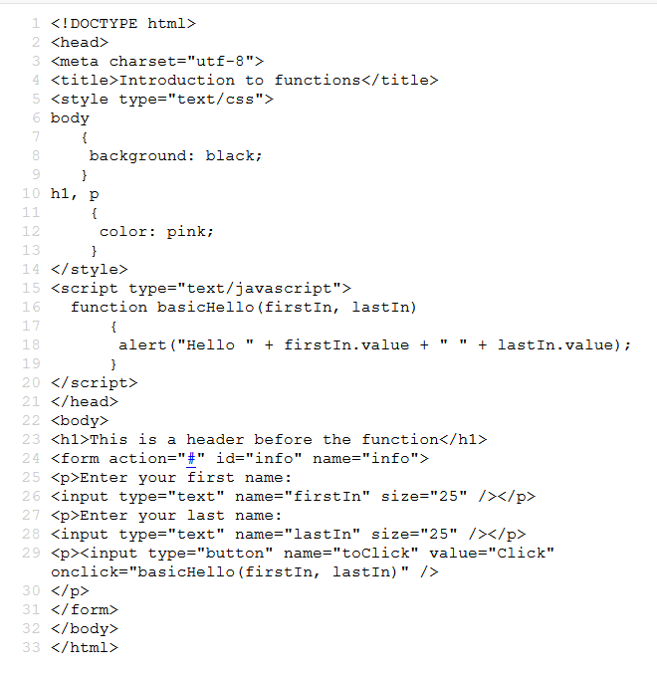
passfunc45.html
passfunc45.html- in this code I am setting up a form to to hold the information. I am using input type with a name of firstIn and a name of lastIn. The form also has a click button you can press to send information to the function.
When you are working with information collected in input type you need to specify that you want to use the value property as opposed to other properties. You need to use firstIn.value and lastIn.value to make this happen.
Note that on the form you do not need action=“#”.

Slide 10
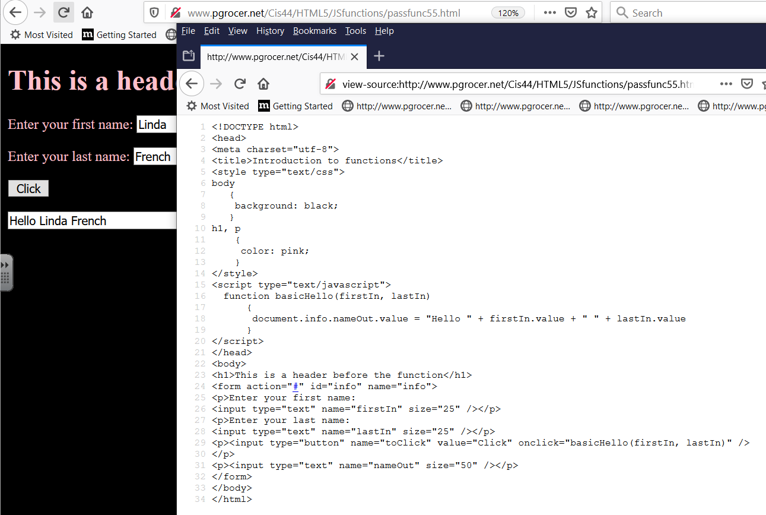
In the function I give the address of nameOut so it can be found. The address is document.info.nameOut.value. Note that the form was called infor and I used both an id and a name. Note also that action=“#” is not needed.

Slide 11
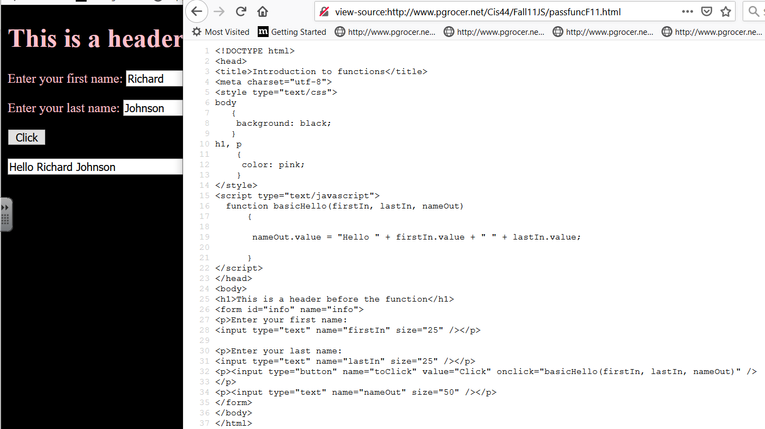
Note that I am sending up an empty nameOut to receive its content in the function.

Slide 12
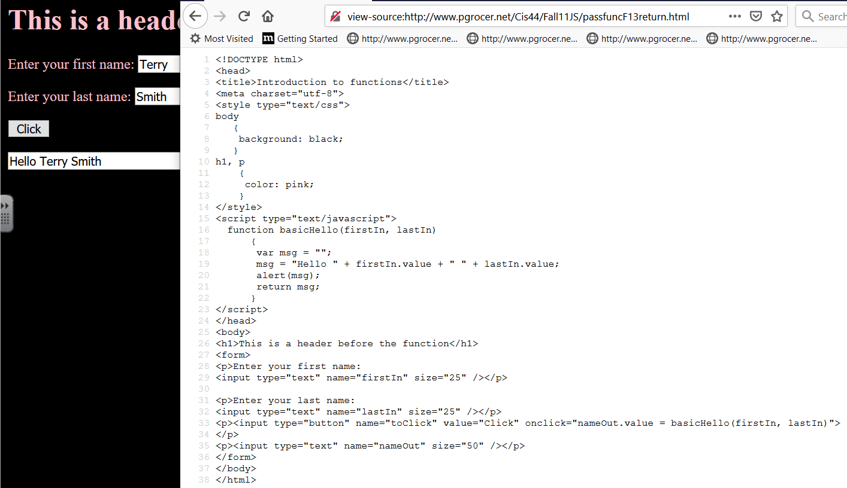
The onclick event in this example means that the basicHello function will be executed and the return will return something from the function that will be stored in nameOut.value.
Many professionals use this approach where they send information to the function and the function returns something that is then assigned to the specified field or memory location.

Slide 13
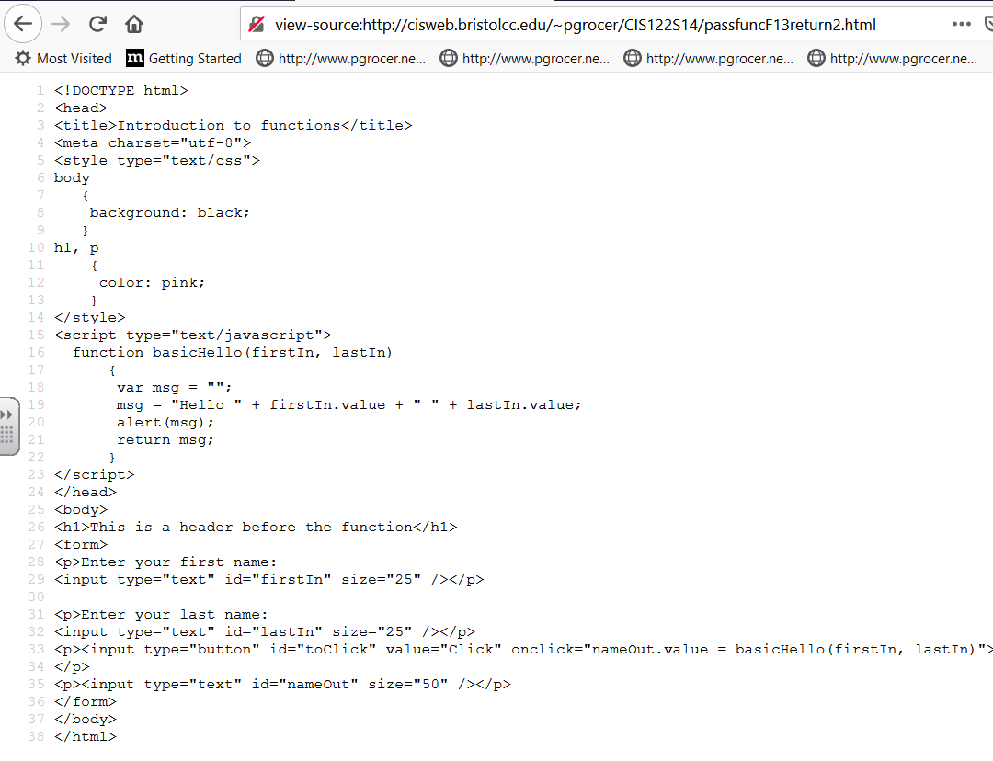
Note that I used name on the last version and id on this version.

Slide 14
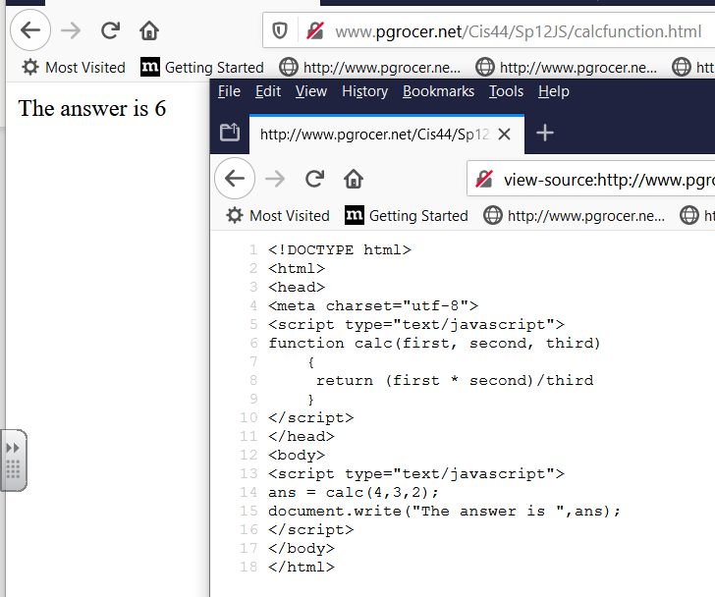
I have sent three literals to the function. Note that these could have been variable names.
I have specified that the result that is returned from the function will be assigned to ans.
The function receives them as first, second, third and then does a calculation and returns the result to ans.

Slide 15
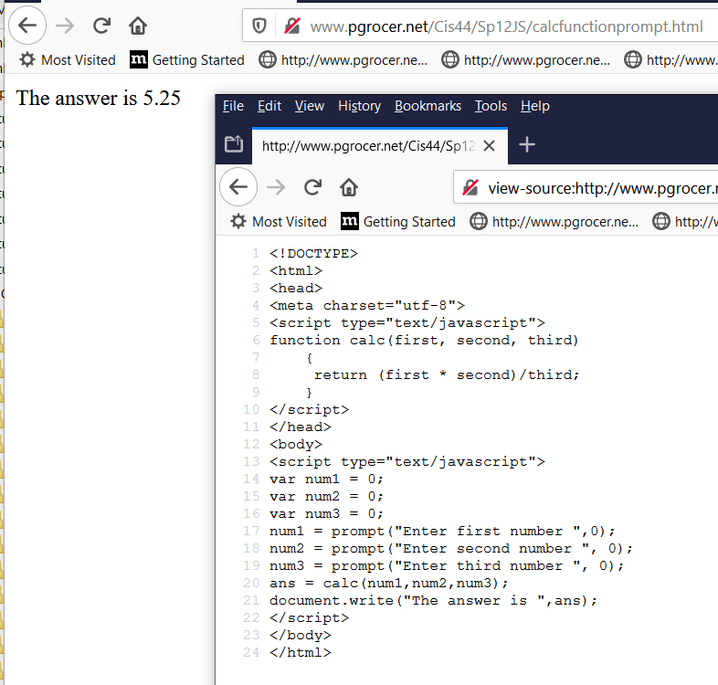
Here I am taking in data with prompts and then sending them to the calc function . When they return they will be assigned to ans.
The function does the calculation and returns it.
The calculation could have been done and assigned to a variable like result and then the return would say return result.

Slide 16
