Slide 1
More DOM
More examples from DOM examples – use the name of the script to test

Slide 2
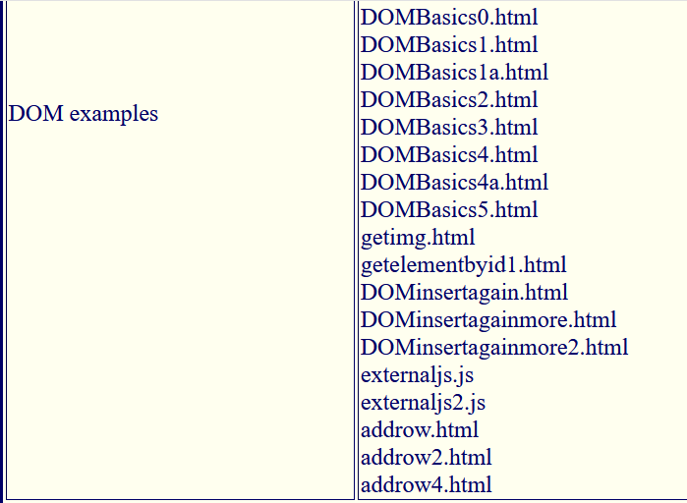

Slide 3
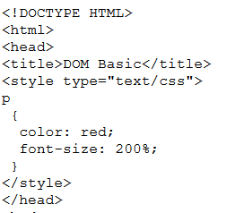

Slide 4
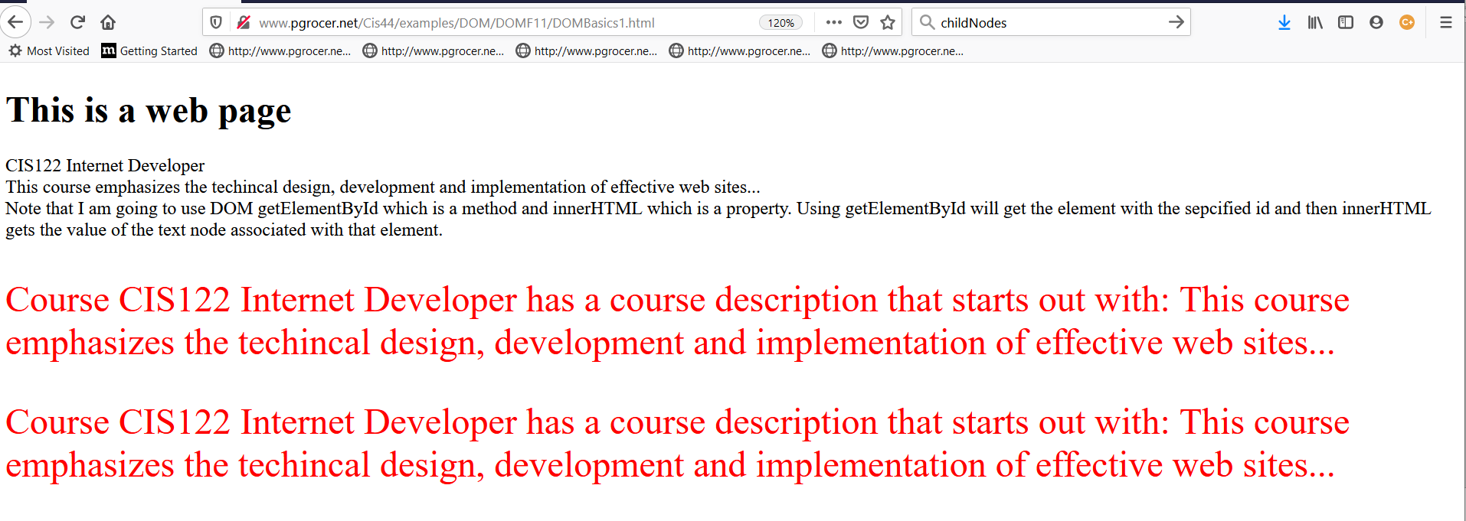
This uses a concept of child nodes. The definition is on the next page and then we will look at the code.

Slide 5
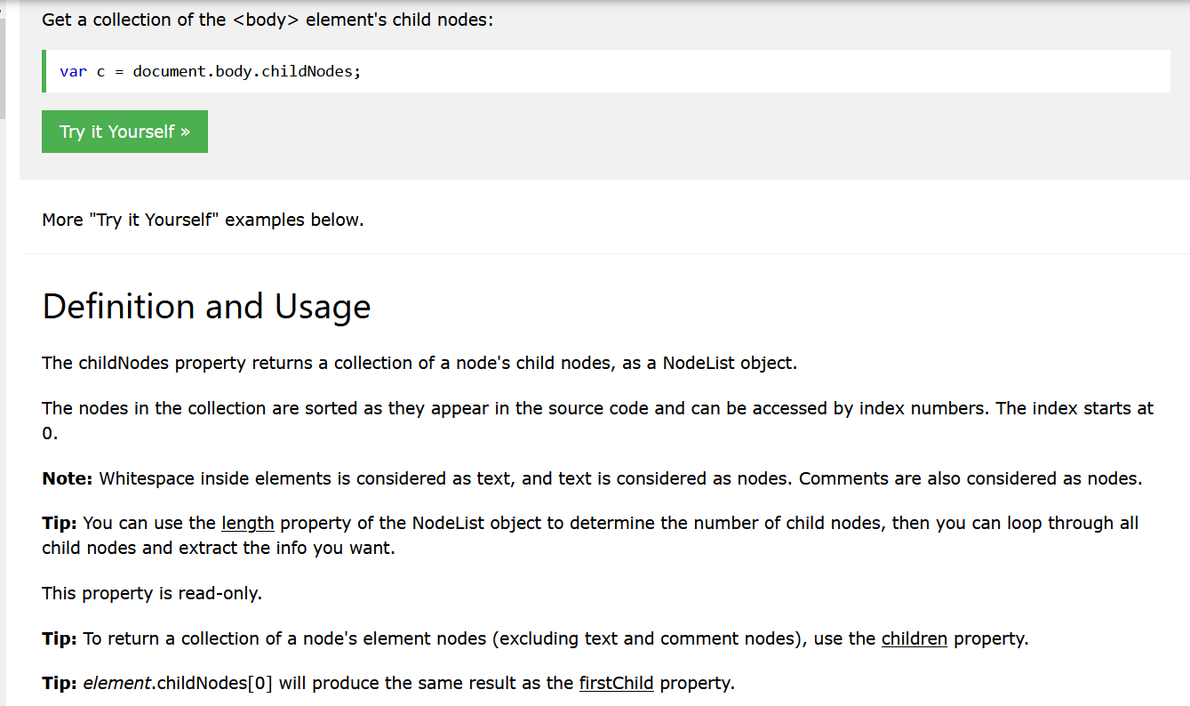
Explanation from W3schools.

Slide 6
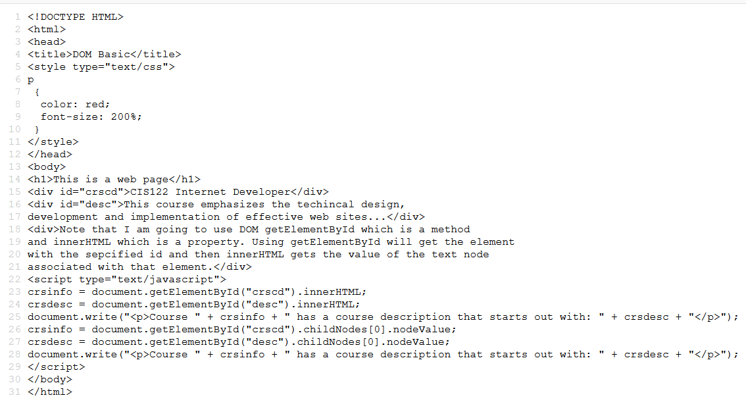
In crscd there was one entry and that was a childNode and we are looking at its value.

Slide 7
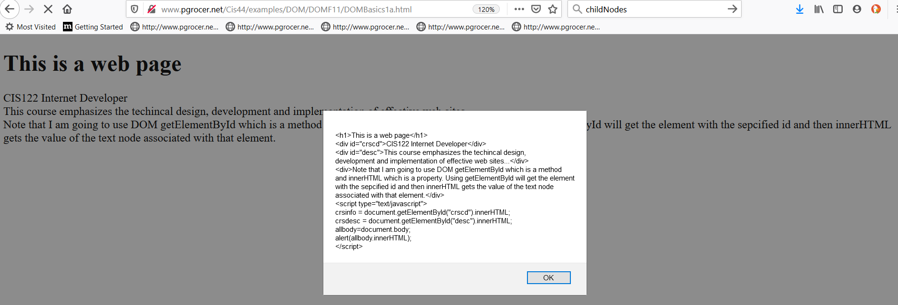
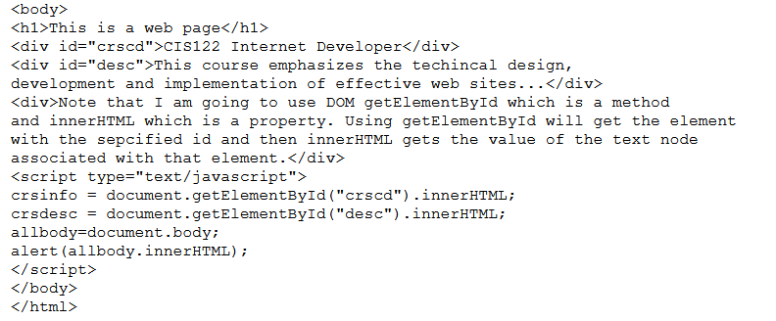
I am defining everything in the document.body as all body and when I alert the innerHTML of allbody I see the popup.

Slide 9
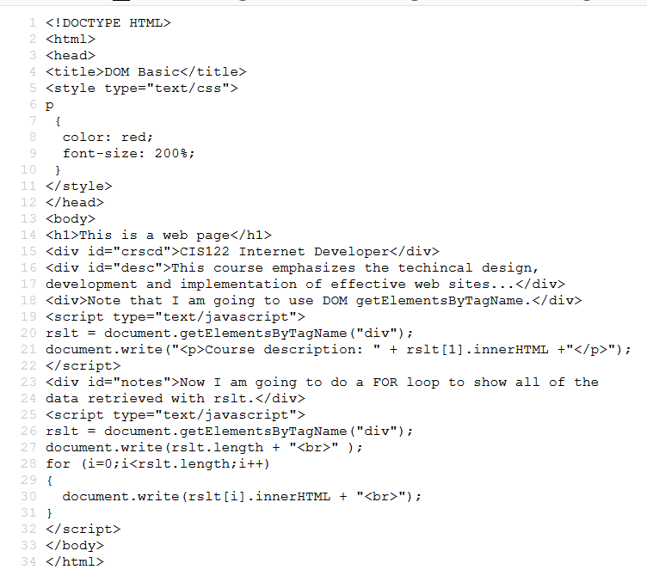
This shows you another possibility of getElement. This time it is getElementsByTagName and I am looking for the tag name div. All of the div will make a background array in rslt. I can then retrieve from rslt using an index.
The FOR loop is using i as the index. It starts i at 0 and ends when i is less than the length of the number of items in rslt. Each pass through, i is increased by 1. Inside the loop rslt(i) is used to show each div in result.
The first div is CIS122 Internet Developer
The second div This course…
The third div is Note…
The fourth div is Now…

Slide 10
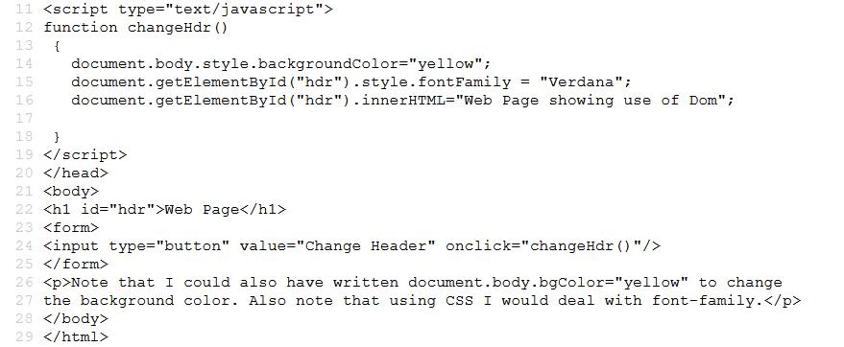

Slide 11
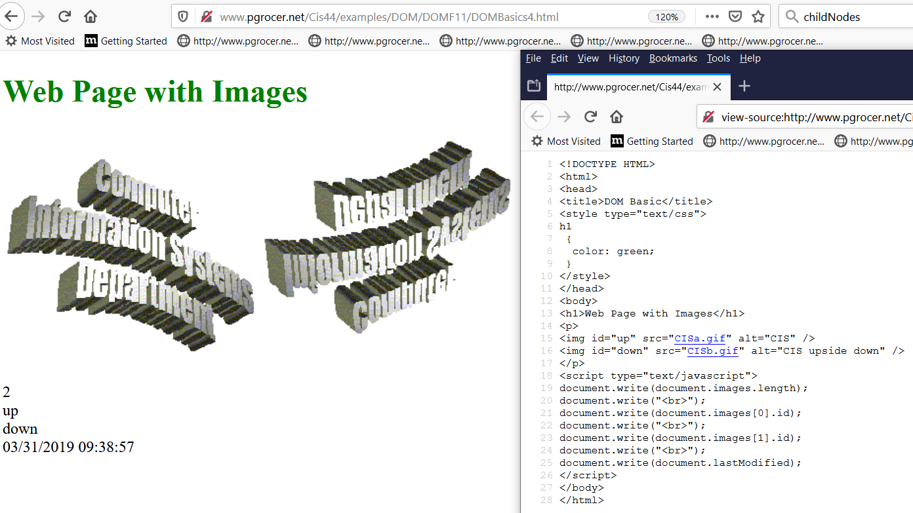
There are two images. The first image is images[0] and the second image is images[1]. For each of these images I want to get the id.

Slide 12
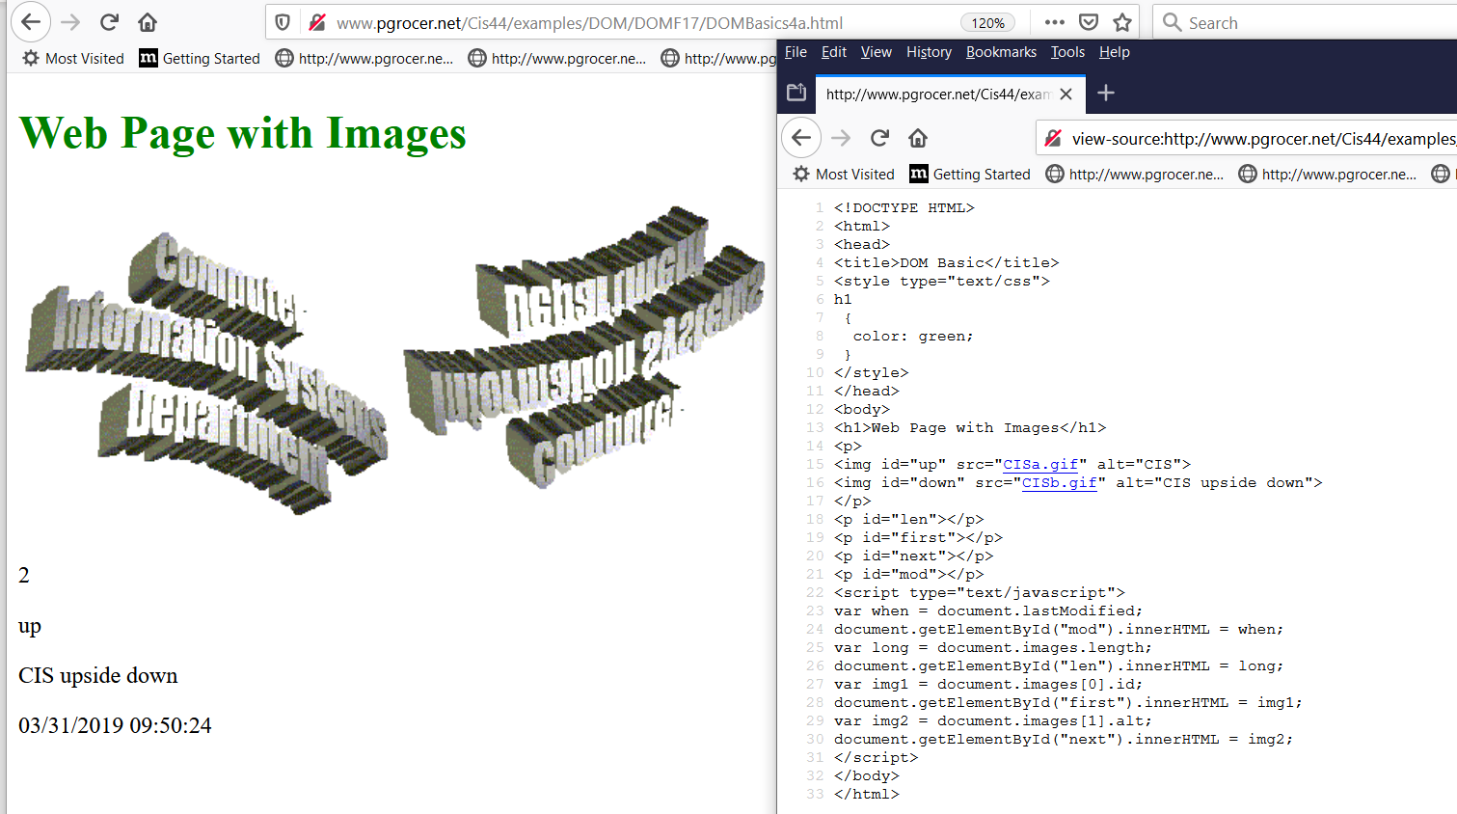

Slide 13
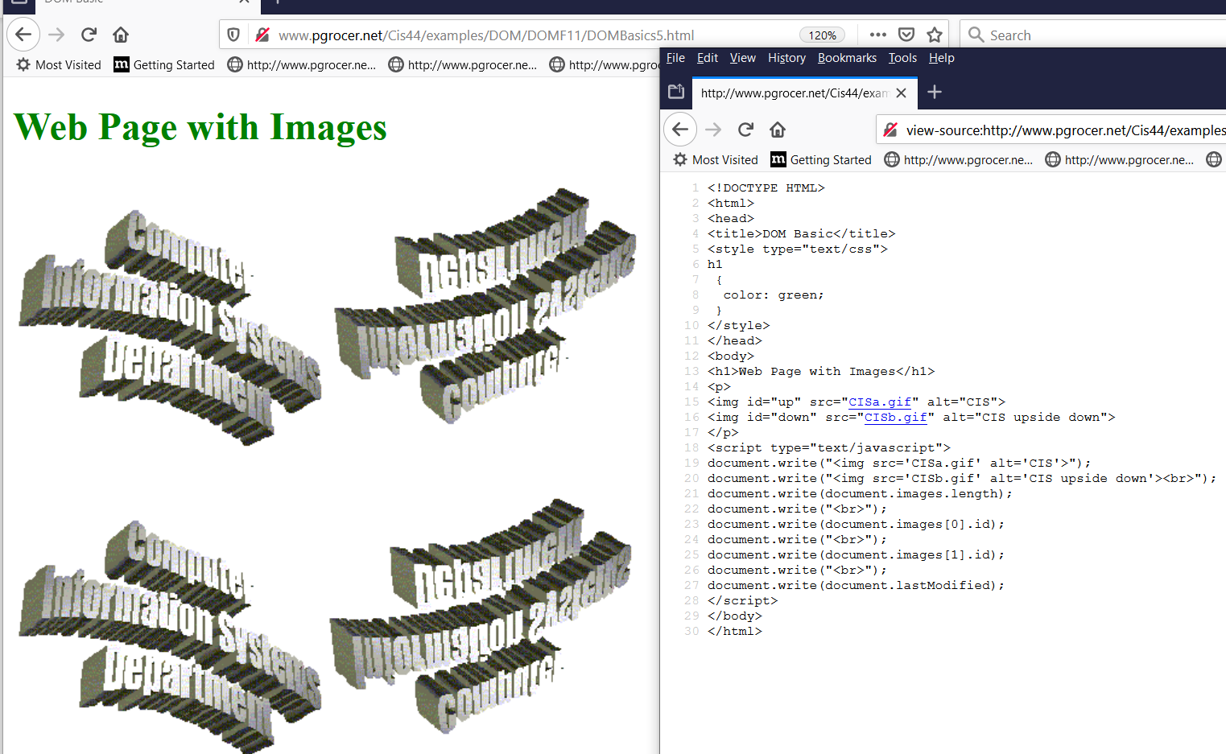

Slide 14
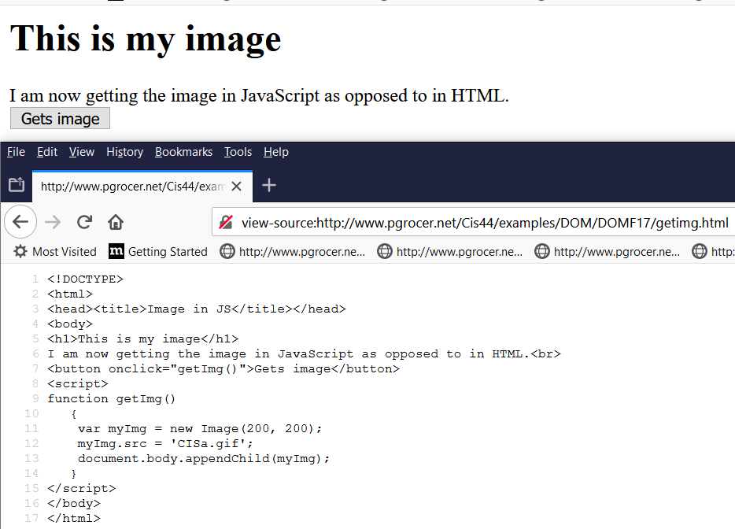
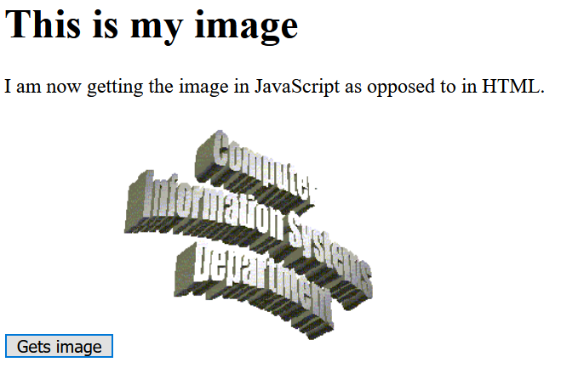

Slide 15
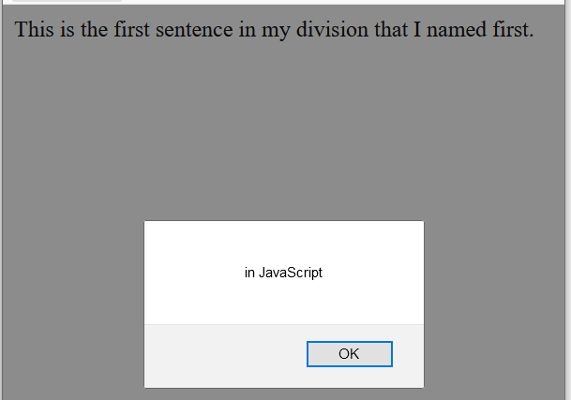

Slide 16
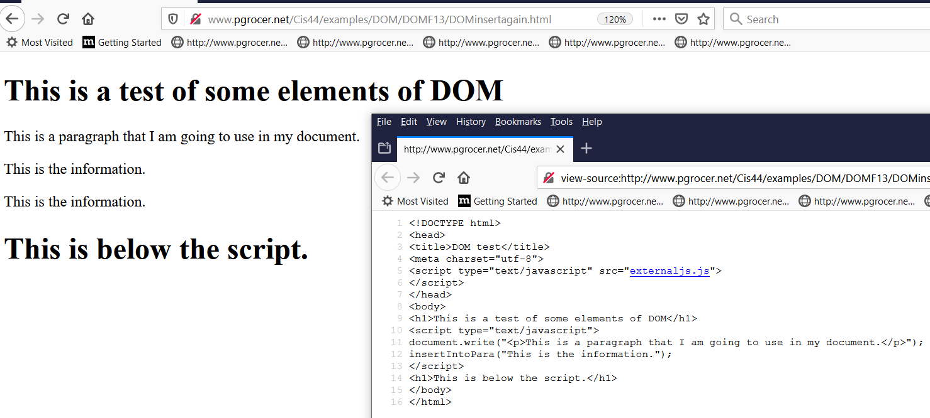
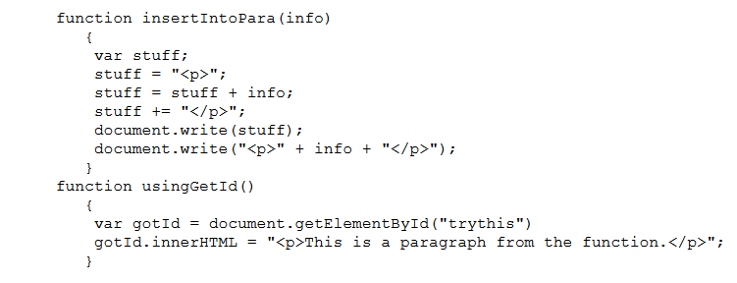
I am linking to external JavaScript which will be included in the script tag.
I need the function insertIntoPara which is in the externaljs.js shown below. Note that I did not use usingGetId() for this script.
This is externaljs.js

Slide 17
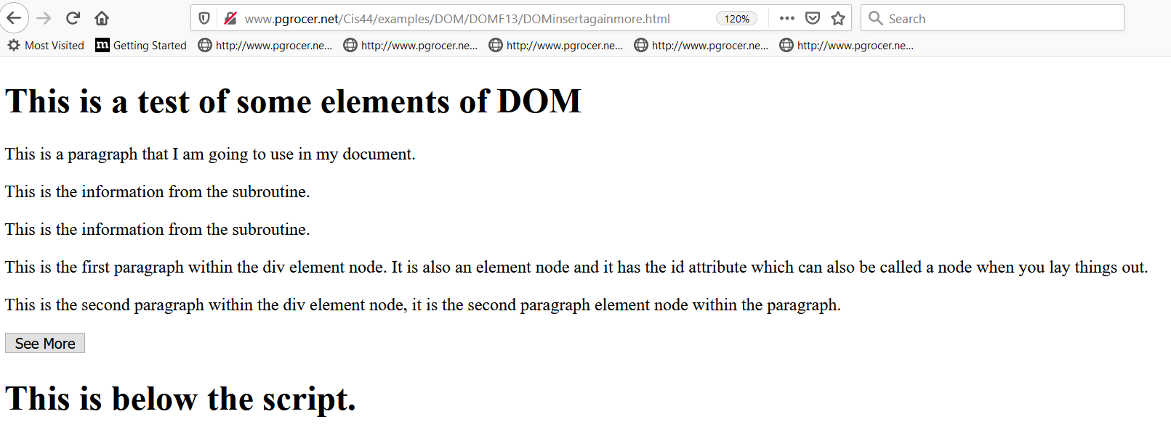

Slide 18
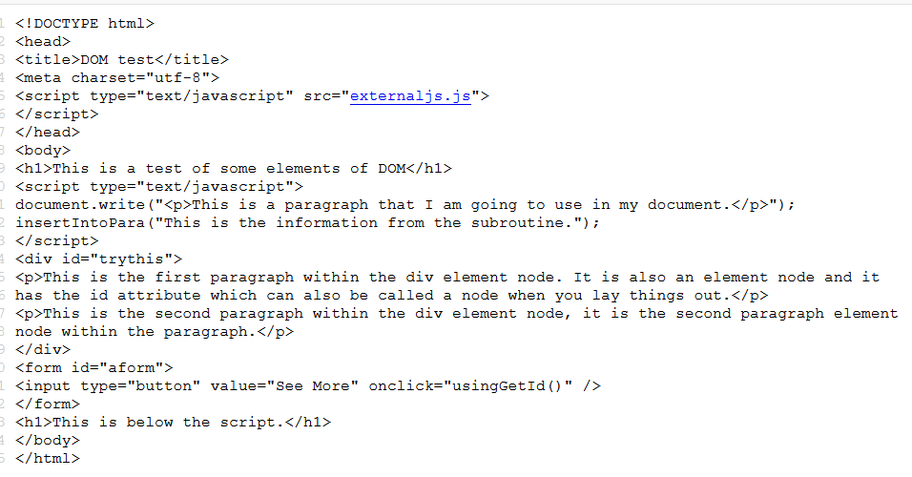
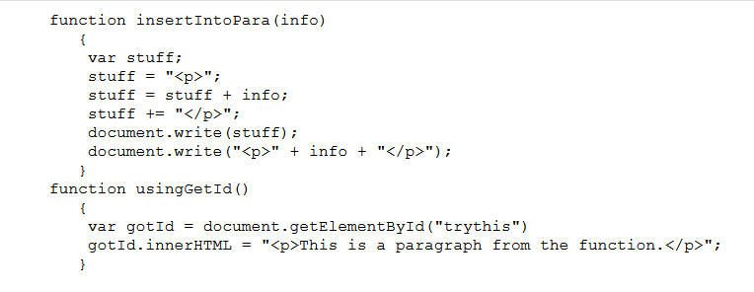

Slide 19
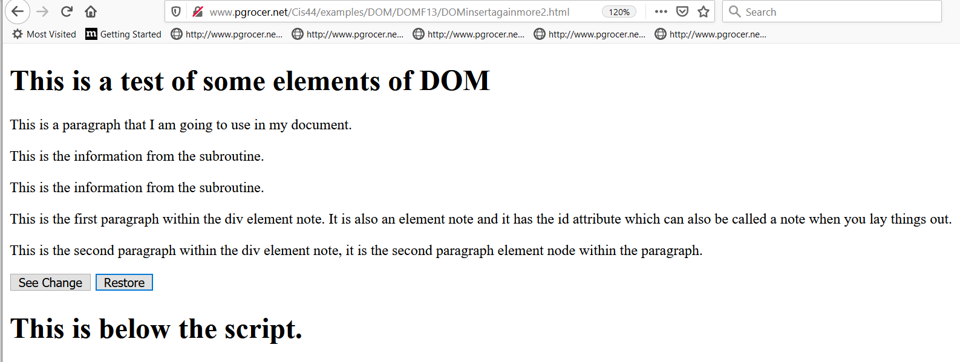
You can cause a change and you can restore the original.

Slide 20
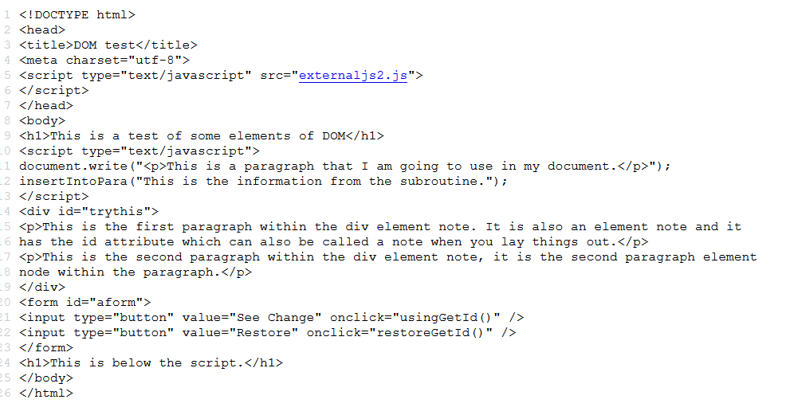
This contains usingGetId() and restoreGetId() which are two functions that are accessed through externaljs2.js. See next page.

Slide 21
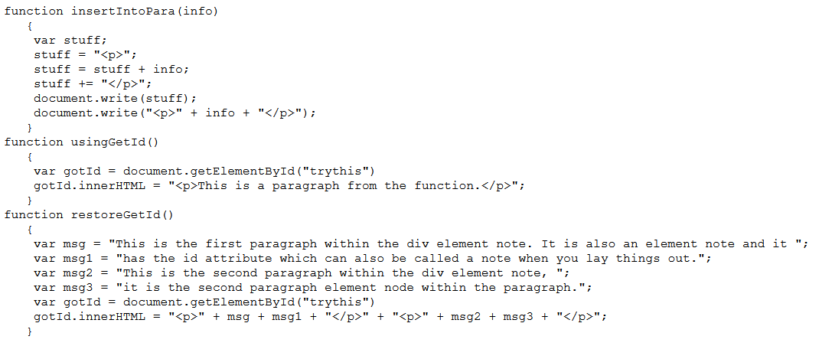
I set up a variable stuff and put <p> in it then I made stuff equal to what is already there plus info and then I made stuff equal to whatever is there (this can be done with stuff + or +=) so
I have the same as the line I write at the bottom of the function.

Slide 22
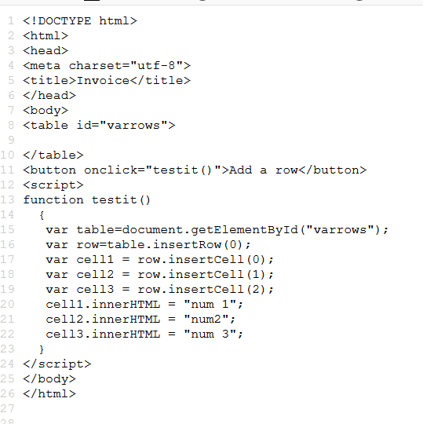
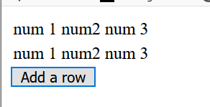
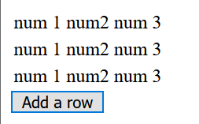
I keep inserting a new row 0 which pushes the other rows down

Slide 23
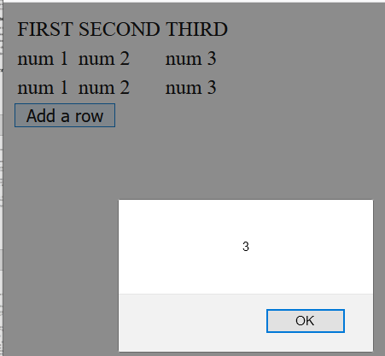
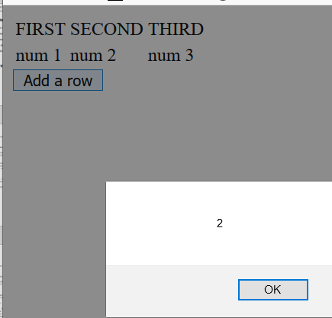
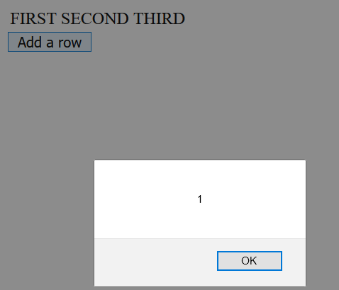
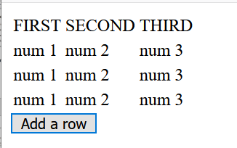
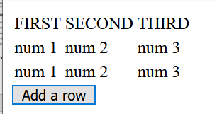
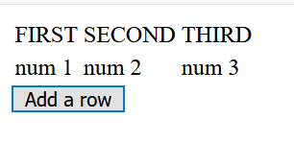

Slide 24
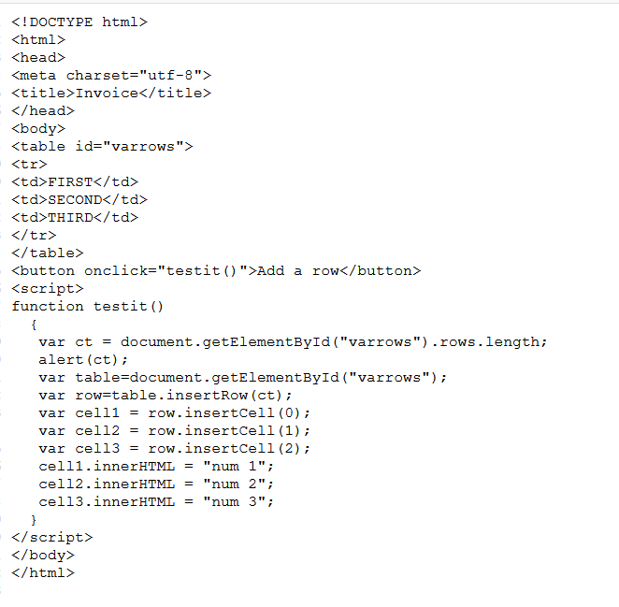
The alert shows what is in ct. It is 1 because I wrote the row saying FIRST SECOND THIRD.
Every time I click a new row gets written.

Slide 27
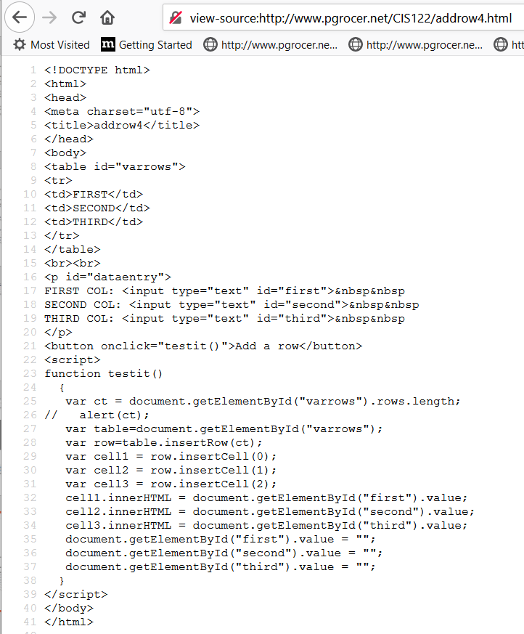
I am setting up textboxes to receive the data.
Now I am using getElementById to put out the row. Notice the use of value associated with textboxes.
Space out the textboxes.

