Slide 1
Connecting to SQLServer
Without using the Wizard
Brief Introduction

Slide 2
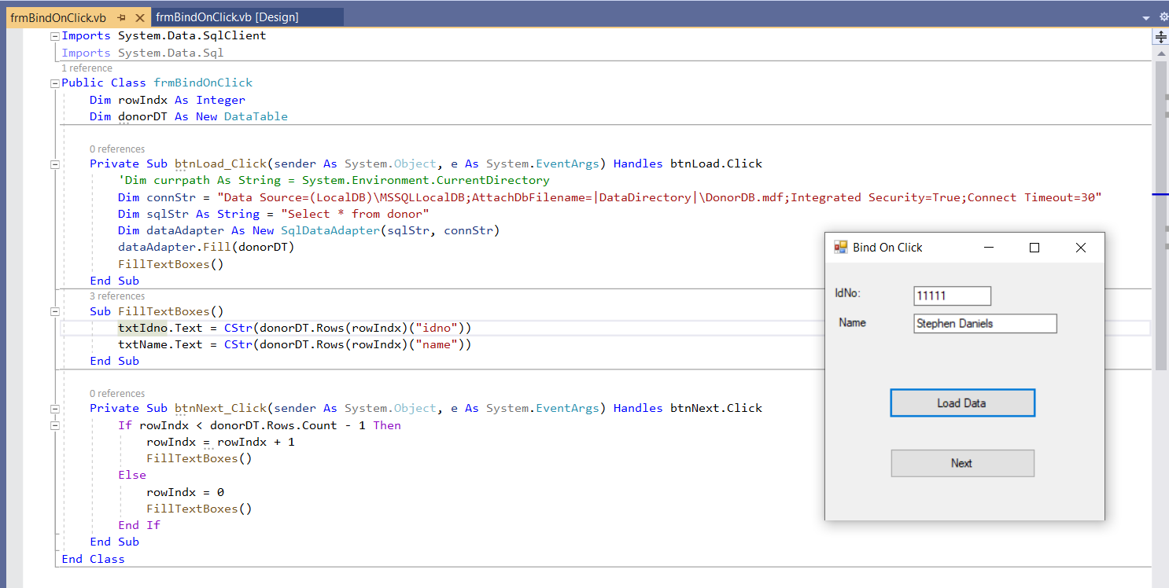

Slide 3
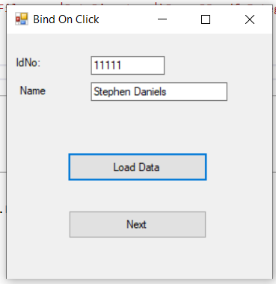
The database I am using is DonorDB.mdf. The code on the next page will show how I set it up in code.

Slide 4
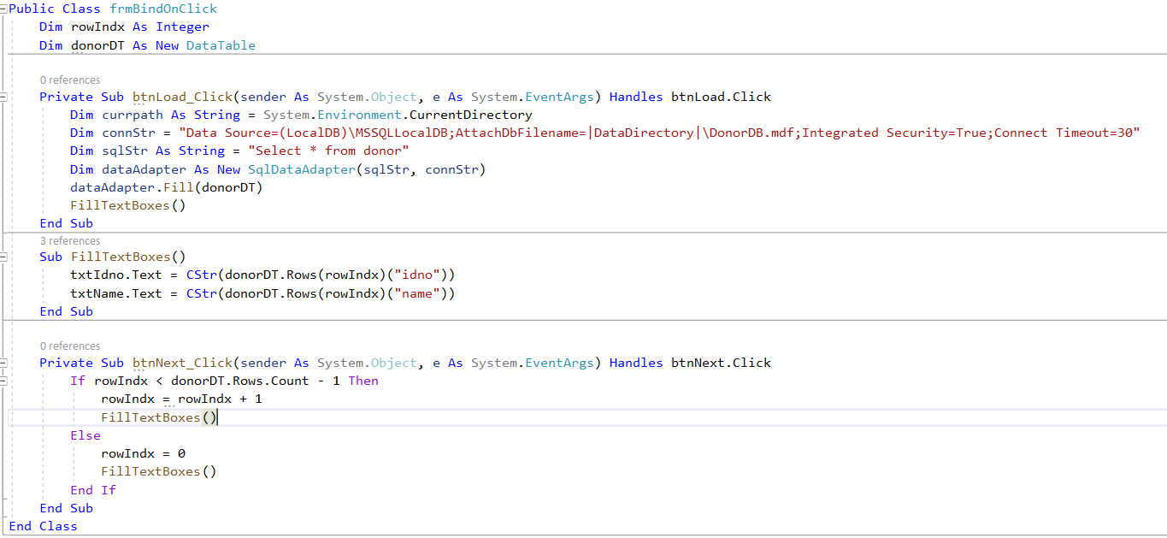
I commented out currpath and it worked fine.
connStr is used to point to the data that is stored in the bin/debug (see previous page)
sqlStr is the select to get what you need using SQL
dataAdapter relates the connStr and the sqlStr and is used to declare the fill of donorDT which was defined as New DataTable
The Sub FillTextBoxes() is where the data is taken from the database table and put into the next boxes.
The btnNext moves through the records and restarts when they have all been shown.

Slide 5
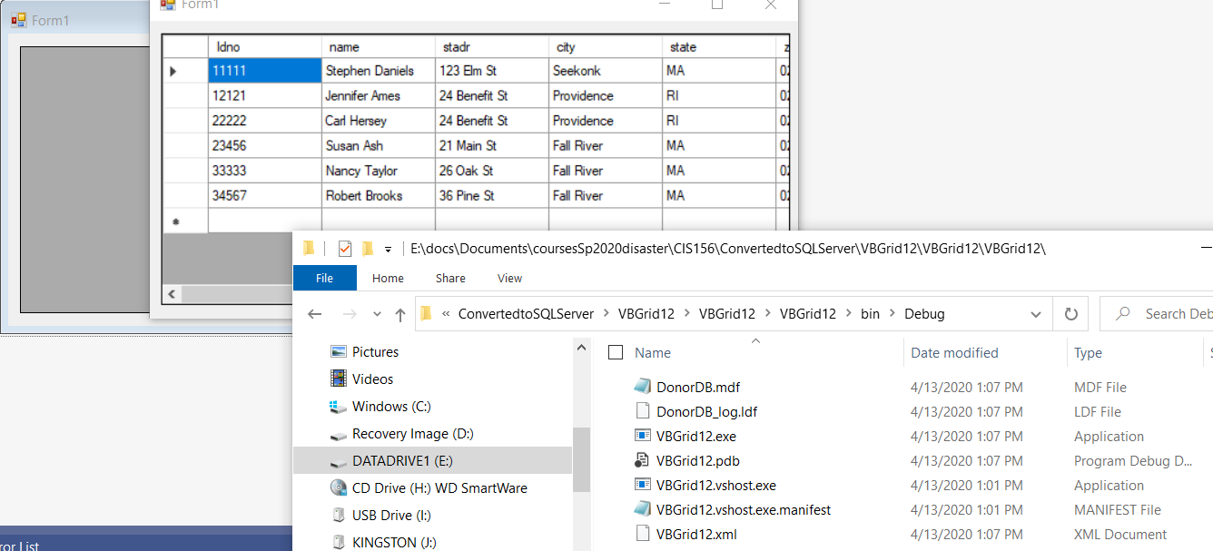

Slide 6
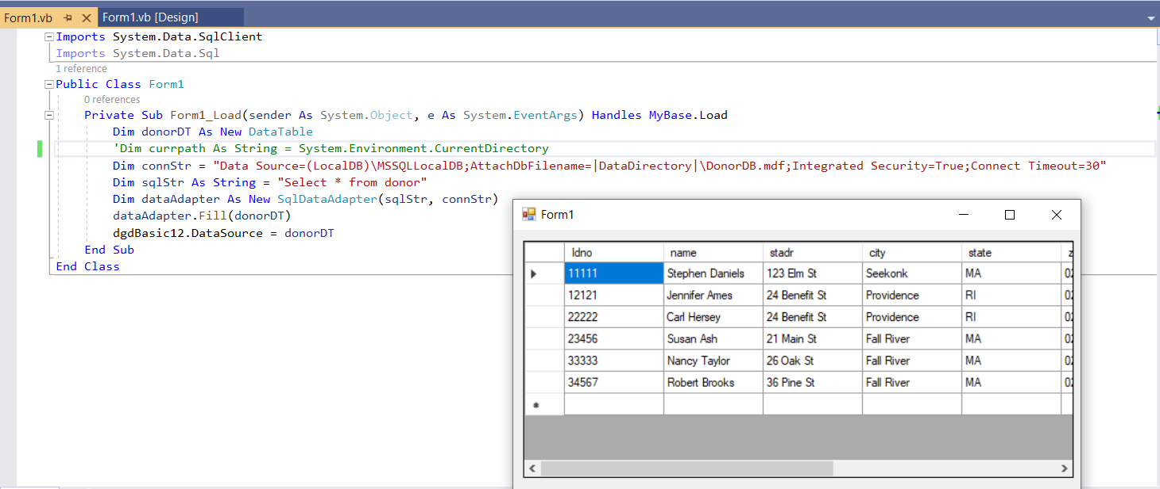
The name of the grid I dragged to the screen is dgdBasic12.

Slide 7
In this example, I used a dataset rather than a table so since there is the possibility of more than one table, I used the dataset name.Tables(0) to indicate the first table.
Note the SELECT which combines information from two tables.

